Slide 1
Accessing The GEF
GEF Trust Fund, STAR
LDCF, SCCF, NPIF, AF
Broadening the GEF Partnership
Public Private Partnership
PMIS and GEF Website
GEF Expanded Constituency Workshop
5 to 6 November 2012
New Delhi, India

Slide 2
GEF Institutional Framework
How to access the GEF Trust Fund

Slide 3
Project Development Steps
Project Idea – Countries – NPFE (optional)
Project Concept – Agencies and countries – PIF & PPG (templates)
Project Endorsement - OFPs
GEFSEC PIF & PPG review, work program inclusion and Council approval
Project Preparation – GEF Agencies, countries and partners
Project document – Agencies, countries and partners – FSP, MSP, EA
GEFSEC review, CEO endorsement/approval and Council information

Slide 4
Project Implementation Steps
Agency approval of project according to own rules and procedures
Implementation start, including inception phase
Ongoing implementation, monitoring and evaluation as per GEF and Agency M&E Policies
Project completion, terminal evaluation, financial closure, including audits and other reports

Slide 5
Responsibilities of Agencies
Project Implementation oversight functions are provided by GEF Agencies :
  Ensure quality of project preparation, meet GEF standards and policies
  Disburse funds to executing agency and supervise project implementation
  Be accountable to GEF Council for project delivery and impacts
  Keep national GEF Operational Focal Point informed, seek his/her endorsement
  Secure committed co-financing
Project execution is managed by the Executing Agency :
  Lead and deliver project outcomes
  Day to day management of project funds
  Report as required to Agency on project results and funds managed

Slide 6
System for Transparent Allocation of Resources (STAR)
Biodiversity, Climate Change, and Land Degradation
All countries have individual allocations
  Minimum allocations: $2 M in CC, $1.5 M in BD,
  and $0.5 M in LD
Flexibility for smaller overall allocations ($7 M)

Slide 7
Programs without Allocations
International Waters
Persistent Organic Pollutants and Sound Chemicals Management
Sustainable Forest Management
Enabling Activities
Cross-cutting capacity development
Country Support Programme
Regional and global projects/programs
Small Grants Programme
Private Sector Engagement

Slide 8
GEF-5
STAR Allocations
 | GEF-5 |  |  |  | PIFs cleared by CEO awaiting approval (M US$) | Allocation Utilized (M US$)
 | Replenishment |  | US$4.25Bn
 | STAR Envelopes (M US$)
Country | CC | BD | LD | Total | Total | Total | Flexible
Bangladesh | 9.65 | 1.88 | 1.12 | 12.65 | .275 | 9.65 | No
Bhutan | 2.00 | 1.96 | 0.53 | 4.50 |  | 3.7 | Yes
Cambodia | 2.21 | 3.85 | 1.22 | 7.28 | 4.262 | 1.288 | No
China | 149.60 | 52.67 | 9.42 | 211.69 | 8.15 | 146.6 | No
India | 93.75 | 30.58 | 5.10 | 129.43 |  | 89.10 | No
Lao PDR | 3.26 | 6.11 | 1.49 | 10.86 |  | 5.58 | No
Malaysia | 14.24 | 14.66 | 1.41 | 30.31 |  | 17.24 | No
Mongolia | 3.19 | 4.33 | 3.34 | 10.86 |  | 7.5 | No
Myanmar | 7.12 | 6.72 | 1.51 | 15.35 |  | 0 | No
Sri Lanka | 2.67 | 7.84 | 2.16 | 12.68 |  | .95 | No
Thailand | 20.10 | 9.05 | 2.48 | 31.63 | 1.46 | 7.4 | No
Viet Nam | 13.89 | 12.12 | 1.50 | 27.52 |  | 15.95 | No
Notes:
This slide is modified depending on the workshop: Comoros,

Slide 9
How to access other funds
– LDCF, SCCF, NPIF, AF
The GEF also manages 3 additional trust funds:
  Least Developed Countries Fund (LDCF)
  Special Climate Change Fund (SCCF)
  Nagoya Protocol Implementation Fund (NPIF)
And provides Secretariat services to the Adaptation Fund (AF)

Slide 10
LDCF and SCCF
LDCF
SCCF
Established to address the special needs of LDCs under the Climate Convention
Only existing Fund mandated to finance the preparation and implementation of NAPAs
49 NAPAs funded already and 76 LDCF projects approved
LDCF resources now amount to US $540 M.
Available to all developing countries, parties to the Climate Convention
Established to support Adaptation and Technology Transfer activities, short and long-term
41 adaptation projects approved, 6 for technology transfer
SCCF resources now amount to US $242 M.

Slide 11
Innovative Features of LDCF/SCCF
GEF TRUST FUND:
Incremental cost
Global benefits
STAR
Co-financing
LDCF & SCCF:
Additional cost principle
NO Global benefits requirement
No STAR
Existing Business-As-Usual (BAU) Financing
Higher MSP ceiling for LDCF ($2M)
Rolling basis approval for
LDCF
Equitable Access for all LDCs under the LDCF

Slide 12
Features of LDCF/SCCF
  The additional cost principle distinguishes LDCF/SCCF projects from the standard GEF practice which funds on the basis of incremental costs.
  Full costs associated with meeting additional costs imposed on the country by effects of climate change, are supported by LDCF and SCCF.
Business-as-usual activities that would be implemented in the absence of climate change constitute a project baseline, (or business-as-usual)
The LDCF follows the principle of Equitable Access. This assures that funding for NAPA implementation will be available to all LDCs, and not be awarded on a first-come, first-served basis. The current cap is $20 million.

Slide 13
How to access LDCF and SCCF funds?
”Accessing resources under the Least Developed Countries Fund” GEF/LDCF.SCCF.9/5/Rev.1 available at the GEF website
”Accessing resources under the Special Climate Change Fund” GEF/LDCF.SCCF.9/6/Rev.1 available at the GEF website

Slide 14
NPIF
NPIF is separate trust fund created and managed by the GEF Secretariat
  Established: February 18th, 2011
Funding is separate from STAR allocations

Slide 15
Timeline
Operational: May 26th, 2011
  GEF Council Meeting (GEF/C.40/11/Rev.1)
Guidance 1: August 18th, 2011
  CEO Letter to Operational Focal Points
Guidance 2: November 11th, 2011
  CEO Letter to Operational Focal Points & GEF Council Members and Alternates
Notes:
Following the CEO emails, the NPIF is for projects leading to ABS agreements between users and providers. Countries can derive lessons towards their national legislations, but not to do tackle that activity in its entirety. They need STAR resources for that.
Summary:
1. GEF Council Paper in May 26th making the NPIF operational. Paper in the June 2011 Council Meeting.
2. In that paper there is a list of activities that could be carried out with funds from the NPIF. Many countries (and UNEP) took that paper and started to prepare PIFs, including an African multi-country project; the one UNEP submitted and we rejected. It is in PMIS.
3. We rejected that PIF because it was developed following the guidance of the May 26th Council document and not the guidance in the CEO email to OFPs dated August 8th. In that email the CEO stated the type projects the NPIF would support; those leading with actual ABS agreements between users and providers of genetic resources, NOT the development of policies, laws and regulations (among other activities) as the UNEP project! Got it?
4. The CEO sent another email on Nov 11 with further clarification regarding the use of NPIF resources. More detailed information.

Slide 16
NPIF: What does it fund?
Projects that:
  Pursue opportunities leading to actual ABS agreements between users and providers of genetic resources
  Promote technology transfer and private sector engagement
  Allow countries to gain information to review capacities and needs on ABS with focus on existing policies, laws and regulations

Slide 17
Accessing the NPIF
Medium Size Projects (MSPs)
  Same policies and procedures as other GEF MSPs
    CEO Approval on a rolling bases
    GEF Agency
    Partner Organizations (Executing Agencies)
    Letter of Endorsement from GEF Operational Focal Point
    Letters of Co-financing
Funding from NPIF: Additional to STAR allocations

Slide 18
NPIF: Where are we now?
Funds available:
  US$15 million (Japan, Norway, Switzerland and France)
Projects approved:
  GEF ID 4780 (Promoting the application of the Nagoya Protocol on Access to Genetic Resources and Benefit Sharing in Panama)
Upcoming Projects:
  16 projects in different stages of development

Slide 19

Adaptation Fund Resources
Proceeds from monetized CERs: 185M
Funds allocated to projects : 166M
Current funding availability: 117.7M
Contributions
Spain: $57,055,000 | United Kingdom: $15,915,000
Sweden: $29,162,773 | Germany: $13,883,000
Switzerland: $3,267,461 | Norway: $87,700
Finland: $67,534 | Monaco: $12,197
Japan: $8,088
Information as of October 2012; all figures in USDD)

Slide 20
Access to Funding
Direct Access
Eligible Parties submit project or programme proposals directly to the Adaptation Fund Board through an accredited National Implementing Entity (NIE).
12 NIEs accredited as of October 2012
Parties submit proposals through accredited regional and sub-regional entities (RIEs).
1 RIE accredited as of October 2012
Multilateral Access
Parties submit proposals through an accredited Multilateral Implementing Entity (MIE).
10 MIEs accredited as of October 2012
Regional Access

Slide 21
Accreditation and Responsibilities for IEs
Fiduciary Standards for Accreditation
Management of Projects
Full responsibility for overall management of projects and programmes
Project Reporting
Responsible for monitoring and reporting
Transparency, self-investigative powers, and anti-corruption measures
Financial management and integrity
Institutional capacity

Slide 22
Project Proposals
Project Size
If the proposed project/programme is larger than US$1M, there is the option of a one-step (full proposal) or a two-step (concept approval followed by full proposal) process
Endorsed Concept
Funding is NOT set aside for project concepts endorsed by the AFB
Projects costing less than US$1M use the one-step process
Public Review
Full Proposal
Most approved project proposals were first submitted as concepts, however, concept endorsement is NOT mandatory
All proposals are posted on the Adaptation Fund website for public comment (www.adaptation-fund.org)
Project concepts are either endorsed, not endorsed, or rejected by the AFB
Full proposals are either approved, not approved, or rejected

Slide 23
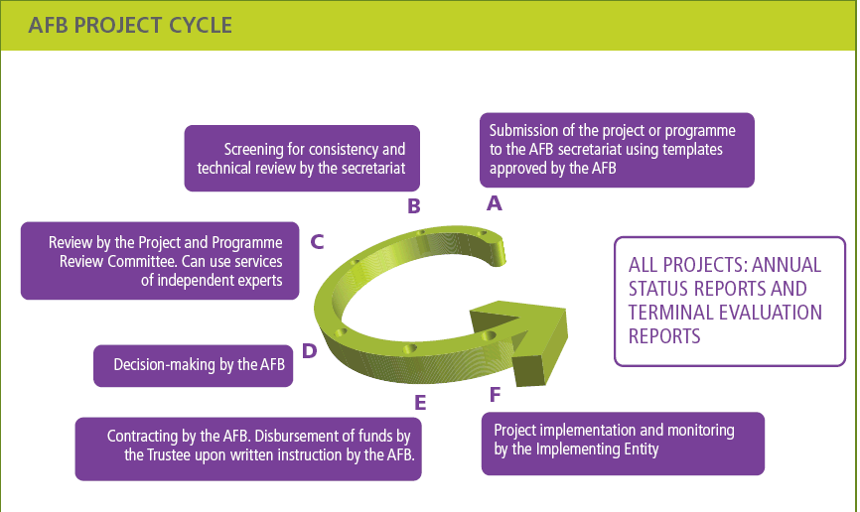

Slide 24
Financing Criteria
Funding provided on full adaptation costs basis for projects/programmes whose principal and explicit aim is to adapt and increase climate resilience
Projects/programmes have to be concrete: emphasis on impacts
No prescribed sectors or approaches
Total allocation for projects/programmes submitted by MIEs cannot exceed 50% of cumulative resources available in the trust fund
  As of August 31, 2012, MIEs have been allocated 48% of total funds
  Funding is more readily available for projects submitted by NIEs, RIEs
All projects/programmes must include a knowledge component
Proposals must align with the Adaptation Fund Results Framework

Slide 25
Project Review Criteria
Consistent with national sustainable development strategies
Benefits to economy, society, and environment
Meets national technical standards
Cost-Effectiveness and sustainability
Gender Issues Considered in Project Design
Stakeholder Consultation: Incorporation of Community Views
Avoiding duplication with other funding sources
Arrangements for management, financial and risk management, M&E, and impact assessment.

Slide 26
Broadening the GEF Partnership
The GEF Council approved, in May 2011, a pilot to accredit up to 10 new institutions to serve as GEF Project Agencies.
At least 5 national institutions
Upon accreditation, GEF Project Agencies can access resources from GEF-managed trust funds directly to assist recipient countries in the preparation and implementation of GEF-financed projects.

Slide 27
Eligibility
Institutions eligible for accreditation under the pilot are:
  national institutions
  regional organizations
  civil society organizations/non-governmental organizations
  United Nations specialized agencies and programs
  other international organizations

Slide 28
Review of Applications
Stage I: Applicants are assessed according to the degree to which they add value to the GEF partnership and align strategically with the GEF’s objectives.
Stage II: Applicants need to fully meet all of the GEF Fiduciary Standards as well as applicable GEF Environmental and Social Safety Standards.

Slide 29
Application Process
Stage I: Internal GEFSEC Value Added Review and Council Approval
Stage II: External Accreditation Panel Review for compliance with the GEF’s Fiduciary Standards and Environmental and Social Safeguards

Slide 30
Stage I Review Criteria
Relevance to the GEF
Demonstration of Environmental or Climate Change Adaptation Results
Scale of Engagement
Capacity to Leverage Financing
Institutional Efficiency

Slide 31
Stage I Applications received (16)
National Agencies (6):
  Uruguay: Agencia Nacional de Investigación e Innovación (ANII)
  Russian Federation: VTB Bank
  Peru: Fondo Nacional del Ambiente (FONAM)
  Brazil : Fundo Brasileiro para a Biodiversidade (FUNBIO)
  China: Ministry of Environment, Foreign Economic Cooperation Office (MEP FECO)
  South Africa: The Development Bank of Southern Africa (DBSA)
  International Civil Society Organizations (4):
  International Union for Conservation of Nature (IUCN)
  World Wide Fund (WWF)
  Conservation International (CI)
  International Federation of Red Cross (IFRC)
United Nations Agencies (2):
  UN World Food Program (WFP)
  UN Human Settlements Programme (UN-HABITAT)
Regional Agencies (4):
  LAC: Banco de Desarrollo de America Latina (CAF)
  Pacific: The Secretariat of the Pacific Regional Environment Programme (SPREP)
  North Africa: Observatoire du Sahara et du Sahel (OSS)
  West Africa: Banque Ouest Africaine de Dévelopment (BOAD)

Slide 32
Eleven applicants have received Council approval in June 2012 to move on to Stage II
National Agencies (5):
  Russian Federation: VTB Bank
  Peru: Fondo Nacional del Ambiente (FONAM)
  Brazil : Fundo Brasileiro para a Biodiversidade (FUNBIO)
  China: Ministry of Environment, Foreign Economic Cooperation Office (MEP FECO)
  South Africa: The Development Bank of Southern Africa (DBSA)
  International Civil Society Organizations (4):
  International Union for Conservation of Nature (IUCN)
  World Wide Fund (WWF)
  Conservation International (CI)
  International Federation of Red Cross (IFRC)
Regional Agencies (2):
  LAC: Banco de Desarrollo de America Latina (CAF)
  West Africa: Banque Ouest Africaine de Dévelopment (BOAD)

Slide 33
Current Status
At the June 2012 Council meeting, 11 agencies were cleared by the for review by an independent accreditation panel.
The Council then decided that it will consider the possibility of inviting a second round of Stage I applications at its November 2012 meeting.
For updates, relevant documents and more detailed information on the accreditation process, please visit
http://www.thegef.org/gef/agencies_accreditation.

Slide 34
Public Private Partnerships in GEF-5
The replenishment created a private sector set-aside of USD 80 million.
Private sector engagement is not an end; it is a means to generate additional global environmental benefits.

Slide 35
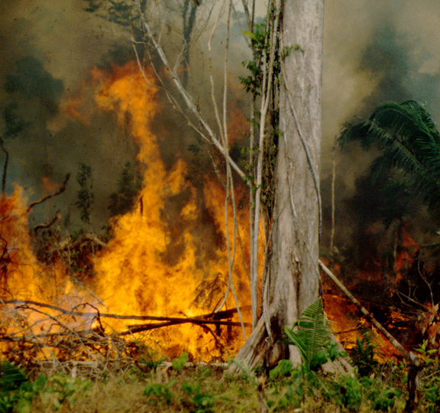
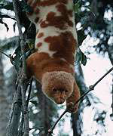
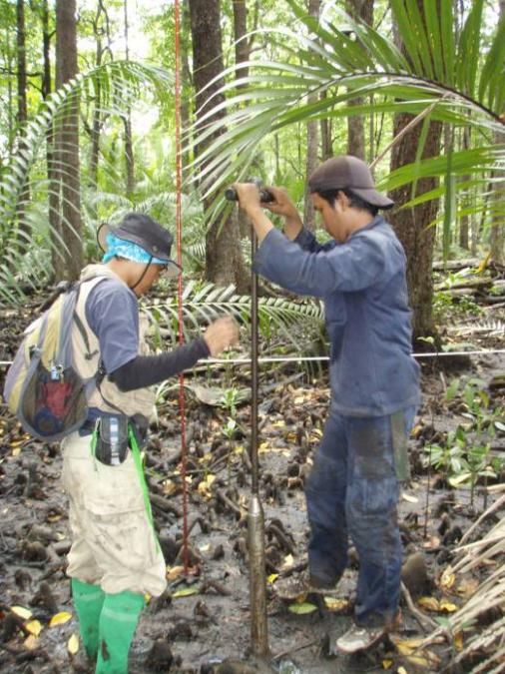
Approved Private Sector Strategy for GEF-5
Three Modalities
Establish Public Private Partnership Programs with multilateral development banks (MDBs) to support investments using non-grant instruments
Encourage countries to use STAR allocation grants for projects with private sector investments using non-grant instruments
Support SME competitions to facilitate technology transfer and entrepreneurship
GEF/C.41/09.Rev.01, Revised Strategy for Enhancing Engagement with the Private Sector
Notes:
Under Modality 1, the MDBs can build programs in any focal area.
PPP Programs can be country, regional, or global in nature.
Many will focus on small and medium enterprises; all will have private sector partners
Under Modality 2, projects using STAR allocation can are eligible to get an incentive from the private sector set-aside if they incorporate a non-grant instrument.
For every three dollars of STAR allocation used, a matching grant of one dollar is available.
Under Modality 3, the GEF will support countries that want to start competitions to recognize innovation and entrepreneurship.
In December, the South Africa announced the winners of their first clean technology competition with GEF and UNIDO support.
Competitions can cover any focal area; adaptation technology is especially encouraged.

Slide 36
What is a Non-Grant Instrument?
Under the GEF instrument, a form of concessional finance that has the potential to earn a return (or reflow).
Reflows are available to expand the pool of GEF resources available for future investments.
Examples:
  Contingent Grant
  Credit Guarantee or Risk Guarantee Fund
  Equity Fund Investments
  Concessional Loans
  Performance Risk Guarantee
  Revolving Fund
  Risk Sharing Fund for Loan Provision
Notes:
Examples:
In Chile, the IADB used GEF funding to establish a risk guarantee fund that is lowering the risk for local banks to fund energy efficiency projects. (#4176)
In a Regional program in Cape Verde, Liberia, Sierra Leone, and Senegal, the World Bank has established a credit line to support the West Africa Regional Fisheries Program. (#3558)
Many other examples of existing use of non-grant instruments are listed in Annex 4 of the GEF revised strategy available on the GEF web-site.

Slide 37
Current Status
GEFSEC has finalized the operational modalities in coordination with the MDBs (C.42.Inf.08)
The GEF June Work Program included two new PPPs
  $20 Million with AfDB for renewable energy loans
  $15 Million with IDB for equity investments in clean energy and bio-diversity
MDBs can submit additional proposals for Public Private Partnership Programs as candidates for inclusion in future work programs.
Agencies and countries can propose the use of non-grant instruments in new PIFs at anytime
GEF is coordinating with UNIDO to identify countries that wish to pursue SME competitions as medium-sized projects.
Notes:
The first two PPP Programs were included in June 2012 work program, and approved by Council. In the documents published for Council approval, one PPP with AfDB focusing on renewable energy and one with IADB addressing clean energy and bio-diversity are presented.
The AfDB project is GEF ID 4929
The IDB project is GEF ID 4959
The GEF is working primarily with UNIDO to pursue SME competitions, based on the successful effort in South Africa, in various countries.

Slide 38
GEF Website
Takeaways:
  Council Member and Focal Point List
  Country Profiles
  Country Fact Sheets
  Country Support Programme
  Documents and Publications:
    Council Documents
    Work Programs
    Program Management Bulletin
    Publications/Videos
  Templates – PIF, Enabling Activities

Slide 39
PMIS
Takeaways:
  Username and Password
  Pre-PIF Tracking Tool
  Project Information:
    Where to find PIFs, PFD, PIRs

