Slide 1
What is the GEF? History and Structure
GEF Expanded Constituency Workshop
Colombo, Sri Lanka
March 17-19, 2015

Slide 2
History of the GEF
1991
1992
1994
2013
$1 billion
pilot program in the WB
At the Rio Earth Summit, negotiations started to restructure the GEF out of the WB
Instrument for the Establishment of the Restructured GEF
GEF serves as financial mechanism for:
CBD
UNFCCC
Stockholm Conv. on POPs
UNCCD
Minamata (Mercury)
Also, although not linked formally to the Montreal Protocol, the GEF supports its implementation in transition economies.
World’s largest public funder of projects and programs to benefit the global environment
Initial partners:
WB, UNDP, UNEP
Notes:
Mission: To assist in the protection of the global environment and to promote environmental sustainable development.
Established in Oct 1991 as a $1 billion pilot program in the WB
The GEF is the world’s largest public funder of projects and programs to benefit the global environment.
WB, UNDP, UNEP were the 3 initial implementing partners.
At the Rio Earth Summit in 1992, the GEF was restructured and moved out of the WB.
This enhanced the involvement of developing countries in the decision-making process and in implementation of the projects.
Since 1994, the WB has served as the GEF Trustee and provided administrative services.
The GEF also serves as financial mechanism for the following UN conventions:
UN Convention on Biological Diversity (CBD)
UN Framework Convention on Climate Change (UNFCCC)
UN Stockholm Convention on Persistent Organic Pollutants (POPs)
UN Convention to Combat Desertification (UNCCD)
The GEF, although not linked formally to the Montreal Protocol on Substances That Deplete the Ozone Layer (MP), supports implementation of the MP in transition economies.

Slide 3
GEF Goal and Mission
Goal: to address global environmental issues while supporting national sustainable development initiatives.
Mission: the GEF is a mechanism for international cooperation for the purpose of providing new, and additional, grant and concessional funding to meet the agreed incremental costs of measure to achieve agreed global environmental benefits.

Slide 4
Institutional Framework
GEF Trust Fund
Guidance
Operations
Action
Agencies
UNDP
UNEP
WB
ADB
AfDB
EBRD
FAO
IaDB
IFAD
UNIDO
WWF-US
CI
IUCN
DBSA
STAP
GEF Assembly
GEF
Secretariat
Projects
Countries:
GEF OFPs / PFPs
Convention FPs
Other Gov’t Agencies
NGOs / CSOs
Private Sector
GEF Council
Countries: Council Members
/ Constituencies
Conventions
CBD
UNFCCC
Stockholm (POPs)
UNCCD
Montreal Protocol
Minamata
GEF
Trustee
Independent
Evaluation Office

Slide 5
GEF Replenishments
GEF Replenishments

Slide 6
Focal Areas/ Themes | GEF-6 Programming Targets ($ million)
BIODIVERSITY | 1,296
STAR Country Allocations | 1,051
STAR Set-aside | 245
- Convention obligations | 13
- Global and Regional Programs | 82
*Integrated Approach Programs | 45
a) Taking Deforestation out of the Commodities Supply Chain | 35
b) Fostering Sustainability and Resilience of Production Systems in Africa | 10
* Other Global and Regional Programs | 37
- Sustainable Forest Management | 150

Slide 7
CLIMATE CHANGE | 1,260
STAR Country Allocations | 941
STAR Set-aside | 319
- Convention obligations | 130
- Global and Regional Programs | 109
*Integrated Approach Programs | 50
a) Sustainable Cities - Harnessing Local Action for Global Commons | 40
b) Fostering Sustainability and Resilience of Production Systems in Africa | 10
*Other Global and Regional Programs | 59
- Sustainable Forest Management | 80
LAND DEGRADATION | 431
STAR Country Allocations | 346
STAR Set-aside | 85
- Convention obligations | 15
- Global and Regional Programs | 50
* Integrated Approach Programs | 40
a) Fostering Sustainability and Resilience of Production Systems in Africa | 40
* Other Global and Regional Programs | 10
- Sustainable Forest Management | 20

Slide 8
CHEMICALS & WASTE | 554
Convention breakdown | 554
- POPs | 375
- Mercury | 141
- SAICM | 13
- ODS | 25
INTERNATIONAL WATERS | 456
Focal Area Programing | 456
CORPORATE PROGRAMS | 197
Country Support Program (CSP) | 23
Cross Cutting Capacity Development (CCCD) | 34
Small Grants Program | 140
Corporate budget: Secretariat, STAP and Trustee | 106
Independent Evaluation Office | 19
TOTAL GEF Replenishment | 4,433

Slide 9
Implementing GEF-6: Use of funds (recipient countries)
=> Trade-off: “Impact” vs ”equity”?

Slide 10
Relations with the Conventions
The GEF serves as "financial mechanism" to five conventions.
The Memorandum of Understanding is the means through which the Conventions and the GEF cooperate.
The conventions, for which the GEF serve as financial mechanism, provide broad strategic guidance to the GEF
The GEF Council responds to this broad guidance by developing operational criteria for GEF projects
Notes:
This slide is modified depending on the workshop

Slide 11
Relations with Convention Secretariats
The Secretariat of the Conventions and the GEF Secretariat consult as necessary in the guidance that the COPs provide
In particular, in accordance with the GEF project cycle, the Secretariat of the Conventions are invited to comment on the project proposals under consideration for inclusion in a proposed work programme.
The GEF Secretariat prepares a report on GEF activities to be presented on each COP on a regular basis. This report is previously reviewed and approved by the Council
Notes:
On the first point this forms the basis of a Secretariat report to the COP on the operations of the MOU between the GEF and the COP.

Slide 12
LDCF and SCCF – Climate Change Adaptation
Least Developed Countries Fund (LDCF)and Special Climate Change Fund (SCCF) -> established in 2001 under UNFCCC COP
First multilateral funds to implement concrete adaptation actions on developing countries
LDCF and SCCF provided vulnerable countries and communities, as well as the GEF Implementing Agencies, initial resources to finance a pioneering adaptation portfolio.
Managed and administered independently from the GEF Trust Fund

Slide 13
GEF and Civil Society
GEF actively engages CSOs in its programs, projects and policies
The GEF has several policies for civil society participation
The GEF provides an opportunity for civil society to participate in many different ways:
At the operational level - CSOs have participated many projects
At the political level – CSOs send representatives to Council Meetings and Assembly with the right to speak on all substantive issues
CSOs have participated at every Expanded Constituency Workshop
The NPFE process was designed to include CSO consultations
In addition, GEF Agencies have policies regarding the participation of civil society and the GEF also works to include their participation through those policies

Slide 14
GEF 2020 – Strategy and GEF 6 strategic priorities

Slide 15
Key Earth systems are near or beyond “tipping points”
Climate change
Chemical pollution
Ocean acidification
Atmospheric aerosol loading
Stratospheric ozone depletion
Biodiversity loss
Nitrogen cycle (biogeochemical flow boundary)
Phosphorus cycle
Change in land use
Glob freshwater use
Not yet quantified
Planetary boundaries have been crossed or nearly crossed
al
Proposed safe operating space for humanity in planetary systems
Source: Rockstrom et al, “A Safe Operating Space for Humanity,” Nature (2009)
Notes:
I want to emphasize three points here. First, some of key earth ecosystems are near or beyond tipping points.
Second, the GEF is operating in almost all of identified ecosystems and have mandate from MEAs.
Third, the GEF is in a prime position to tackle those tipping points most effectively by adopting an integrated approach.
WE ARE THE ONLY INSTITUTION TO BE ABLE TO ADDRESS THESE CHALLENGES IN AN INTEGRATED AND HOLISTIC APPROACH

Slide 16
GEF 2020 Strategy
A new strategy aimed at making the GEF an even more centralized actor in the international environmental arena and at achieving impacts at the scale
Outline of GEF2020 Strategy
Focus on drivers of environmental degradation
Deliver integrated solutions, given that many global challenges are interlinked
Forge close relationships with a variety of stakeholders
Finance resilience and adaptation
Ensure complementarity and synergies in climate finance

Slide 17
Three Key Operational Priorities
Mobilize local and global stakeholders (national and local governments, private sectors, civil society)
Improve GEF operational efficiencies
Strengthen Results Management
Underpinned by Focal Area Strategies

Slide 18
1. Address drivers of environmental degradation
Underlying
socioeconomic trends
Indirect environmental drivers
Direct
environmental drivers
Environmental pressures
Changes in state of environment
Demand for food production
Agriculture production processes that produce food
Pollution e.g., GHG’s & ozone-depleting substances
Atmosphere (climate)
Population growth
Demand for buildings
Biodiversity
Provision/use of transportation
Change in habitat and species loss
Rising middle class
Demand for energy
Construction & use of buildings & other infrastructure
Land
Introduction of invasive species
Demand for
transportation
Oceans
Production of electricity
Over exploitation and harvesting
Urbanization
Other
Other
Other
Freshwater
Driver interventions
Pressure interventions
Changes in human welfare
Notes:
**This slide is animated**
Animation 1
How we can most effectively address degradation of global environment? Let us start with our immediate concerns; degradation of global environment.
Animation 2
In order to explore the most impactive way to address degradation, let us look at the trends behind these tipping points.
There are three mega-trends; Population growth, rising middle class, and urbanization. This will have incredible implications on global consumption and production patterns, which will go on the collision course with nature if BAU continues.
At the end of this causal chain, we know that these underlying trends result in degradation of the global environment. The question is– what happens in between?
Animation 3
First you have the drivers of environmental degradation– deriving from 3 mega-trends. How to meet doubling demand for food, transport and energy? Specifically, agriculture, buildings, power, transportation and other sectors like oil & gas contribute to unsustainable production and consumption.
Animation 4
These drivers result in direct pressures on the environment. These we are all familiar with: the GHG emissions that lead to climate change; the deforestation that leads to biodiversity loss, etc.
So as you look at the whole chain, you can see how this story plays out.
For example, the rise of an urban, middle class is leading to higher demand for and production of beef and palm oil. This has led to loss of natural forests and draining of peat lands, more usage of chemical fertilizer and water, which affects several aspects of the global environment.
Animation 5
This science helps us narrow our focus on what is most important. I believe the GEF needs to focus on tackling drivers, not just the direct environmental pressures of degradation. There are 3 reasons.
First of all, drivers will have more systemic impact than addressing direct environmental pressures will. “An ounce of prevention is worth a pound of cure.” The same can be said for addressing global environmental issues.
Secondly, drivers deliver multiple global environmental benefits at scale. Food production, for example, contributes to significant greenhouse gas emissions, uses large amounts of freshwater, is a major contributor to water pollution, and introduces many toxic chemicals into the environment through use of pesticides and herbicides.
Finally, drivers better position the GEF to articulate how global environmental goals contribute to broader socio-economic development goals. This approach is supportive of the global community’s efforts to eradicate poverty and transform economies through sustainable development as part of the Post-2015 Development Agenda.
SO YOU CAN SEE HOW IMPORTANT IT IS FOR US TO FOCUS ON THE DRIVERS IF WE HOPE TO HAVE THE IMPACT WE NEED

Slide 19
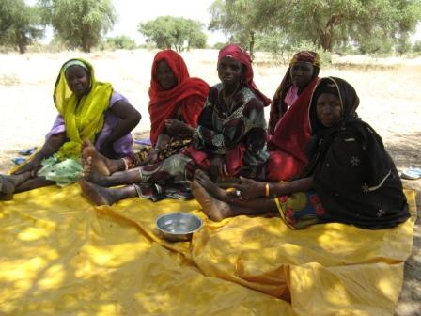
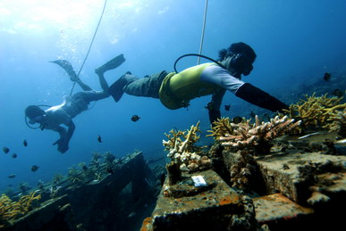
2. Deliver Integrated Solutions
Example: Integrated approach programs (IAPs) in GEF-6:
Sustainable Cities
Deforestation out of Commodity Supply
Fostering Sustainability and Resilience for Food Security in Sub-Saharan Africa
An increasing portfolio of multi-focal area projects and programs

Slide 20
GEF-6 Programming
Systemic Solutions for System Problems
Selected SD Themes
Commodities
Food Security
Cities
Integrated Approach Pilots
Land Degradation
Biodiversity
International Waters
Sustainable Forest Management
Climate Change
Chemicals
and Waste
Focal /
Multi-focal Area Strategy Delivery
Notes:
Taking Deforestation out of the Commodities Supply Chain
Avoiding deforestation in supply chains of critical commodities by supporting action with financial institutions, and producers
A New Development Path for the Amazon Basin
Enhance the development options available for the region, that are more reliant on a strong forest-related sector ,can reduce poverty and stabilize the agriculture frontier

Slide 21
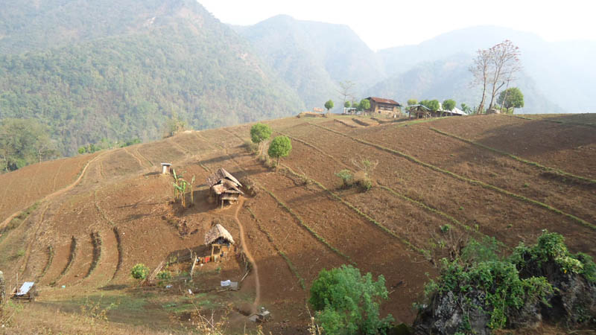
3. Enhance Resilience
GEF Adaptation Program:
LDCF, SCCF
124 countries worth
US$1.2 billion
National adaptation plans (NAPs)
Ecosystem based adaptation

Slide 22
4. Ensure Complementarity in Environmental Finance
Increasingly complex climate finance architecture
GEF “niche”:
Transforming policy and regulatory environments; build institutional capacity
Demonstrate new technology and business models
De-risk partner investments
Build multi-stakeholder alliances

Slide 23
Implementing GEF-6
Through strategic partnerships
Address global environmental issues where a country plays a pivotal role
Activities that cut across multiple focal areas and sectors, and promote integrated approach in achieving your national development objectives. Identify those areas in your National Plans where GEF can support policy, market or behavioral transformations.
Combine GEF resources with other existing resources from other donors and the government, and thus leveraging the impact in advancing national environmental priorities

