Slide 1
– The GEF – Overview and Update
GEF Expanded Constituency Workshop
Livingstone, Zambia
16 to 18 July 2013

Slide 2
History of the GEF
1991
1992
1994
2013
$1 billion
pilot program in the WB
At the Rio Earth Summit, negotiations started to restructure the GEF out of the WB
Instrument for the Establishment of the Restructured GEF
GEF serves as financial mechanism for:
CBD
UNFCCC
Stockholm Conv. on POPs
UNCCD
Mercury (NEW)
Also, although not linked formally to the Montreal Protocol, the GEF supports its implementation in transition economies.
World’s largest public funder of projects and programs to benefit the global environment
Initial partners:
WB, UNDP, UNEP
Notes:
Mission: To assist in the protection of the global environment and to promote environmental sustainable development.
Established in Oct 1991 as a $1 billion pilot program in the WB
The GEF is the world’s largest public funder of projects and programs to benefit the global environment.
WB, UNDP, UNEP were the 3 initial implementing partners.
At the Rio Earth Summit in 1992, the GEF was restructured and moved out of the WB.
This enhanced the involvement of developing countries in the decision-making process and in implementation of the projects.
Since 1994, the WB has served as the GEF Trustee and provided administrative services.
The GEF also serves as financial mechanism for the following UN conventions:
UN Convention on Biological Diversity (CBD)
UN Framework Convention on Climate Change (UNFCCC)
UN Stockholm Convention on Persistent Organic Pollutants (POPs)
UN Convention to Combat Desertification (UNCCD)
The GEF, although not linked formally to the Montreal Protocol on Substances That Deplete the Ozone Layer (MP), supports implementation of the MP in transition economies.

Slide 3
Institutional Framework
GEF Trust Fund
Guidance
Operations
Action
GEF Assembly
GEF
Trustee
STAP
Projects
Countries:
GEF OFPs / PFPs
Convention FPs
Other Gov’t Agencies
NGOs / CSOs
Private Sector
GEF Council
Countries: Council Members
/ Constituencies
GEF
Secretariat
GEF Agencies
UNDP
UNEP
WB
ADB
AfDB
EBRD
FAO
IaDB
IFAD
UNIDO
Conventions
CBD
UNFCCC
Stockholm (POPs)
UNCCD
Montreal Protocol
Mercury
Evaluation Office

Slide 4
Responsibility of GEF Agencies (1 of 2)
Implementing Agency – Project Oversight
Ensure quality of preparation
Disburse funds to Executing Agency
Supervise implementation
Be accountable to GEF Council
Keep GEF OFP informed
Help secure committed co-financing

Slide 5
Responsibility of GEF Agencies (2 of 2)
Executing Agency – Project Management
Deliver project outcomes
Day-to-day management of funds
Report on results and use of funds

Slide 6
STAR Allocations | GEF-5 Replenishment US$4.25Bn |  |  |  | Allocation Utilized (M US$)
 | STAR Envelopes (M US$)
Country | CC | BD | LD | Total | Total | Flexible
Angola | 5.18 | 6.99 | 3.48 | 15.65 | 9.95 | no
Botswana | 3.18 | 2.11 | 5.21 | 10.5 | 6.64 | No
Lesotho | 2.00 | 1.50 | .81 | 4.31 | .334 | Yes
Malawi | 2.00 | 4.39 | 1.19 | 7.58 | 4.12 | No
Mozambique | 3.19 | 7.0 | 2.87 | 13.06 | 8.08 | No
Namibia | 2.00 | 6.28 | 5.69 | 13.97 | 12.18 | No
South Africa | 25.71 | 21.68 | 5.25 | 52.64 | 37.86 | No
Swaziland | 2.00 | 1.50 | 2.69 | 6.19 | 6.09 | Yes
Zambia | 3.77 | 4.26 | 3.01 | 11.04 | 11.04 | No
Zimbabwe | 2.0 | 1.72 | 2.87 | 6.59 | 6.58 | Yes
TOTAL |  |  |  | 141 | 103
Notes:
This slide is modified depending on the workshop

Slide 7
New GEF Fee Policy
Start Date
The Council requested the Secretariat to begin implementation of the new structure beginning 01 Jan 2013.
Percentages
All projects approved/cleared by CEO will be subject to the new fee policy as follows:
9.5% for GEF project grants up to and including $10 million
9.0% for GEF project grants above $10 million

Slide 8
GEF Project Cycle
Streamlining Measures
PPG included in PIF template
MSP ceiling - $2 million
All templates simplified
Milestones monitored by GEFSEC
Agency fees:
40% at Council approval
60% at CEO endorsement
Umbrella projects for EAs approved by Council – No separate endorsement for individual projects.
Notes:
Streamlining measures approved by the Council in June 2012

Slide 9
Harmonization
Oct 2012: WB Harmonization Pilot discussion starts with the WB
Objective
To reduce administrative burden through involvement of GEF’s Program Managers in project design.
What has been harmonized
No Parallel Process for Decision Making
No GEF Review Sheets
No GEF-specific Project Templates
New business standard: from a 10 to a 5-day response

Slide 10
Broadening the GEF Partnership
June 2013 Council:
World Wildlife Fund-US and Conservation International have received approval from the independent review panel to become GEF Partners.
A second round of accreditation, including accreditation of bilateral agencies could happen only once all Stage II reviews are completed.
Notes:
Size and regional balance - being one from an LDC, and another from a middle-income country

Slide 11
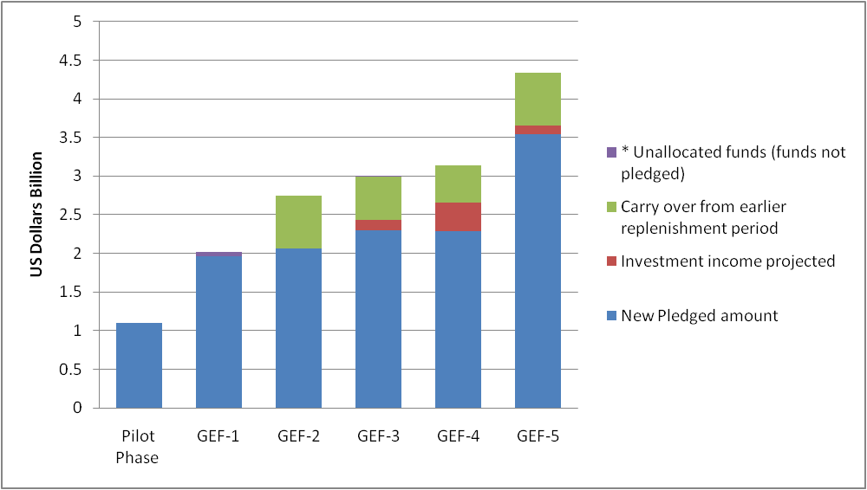
GEF-6 Replenishment (1 of 3)
Replenishment: process in which donor countries, every 4 years, voluntarily pledge to provide resources to fund the GEF operations.
Previous Replenishments
Notes:
Evolution of the GEF – Major Reforms
Independent GEFEO – (Called for as GEF-3 reform.)
Direct access for Executing Agencies (GEF-3 reform, deepened in GEF-4)
RAF to STAR – GEF-3, GEF-4, GEF-5.
Fiduciary Standards – GEF-4 reform
Results-based Management – GEF-4 reform
Country Drivenness – a focus of several replenishments, including GEF-5
Direct Access for Convention Reports – GEF-5 reform
Streamlining Project and Program Cycles – GEF-4, GEF-5
Broadening of Partnership - Accreditation of new agencies (GEF-5)
Key Programming Areas
Biodiversity (Focal Area)
Climate Change Mitigation (Focal Area)
International Waters (Focal Area)
Land Degradation (Focal Area)
Chemicals – includes Ozone Depletion FA, Persistent Organic Pollutant FA, and Sound Chemicals Management & Mercury
Sustainable Forest Management/REDD+
Corporate Programs: Small Grants Program, Country Support Program, Private Sector Activities
GEF-6 will likely also include a communications strategy.

Slide 12
GEF-6 Replenishment (2 of 3)
Composition
GEF Trustee (Chair)
GEF CEO (Co-Chair)
Donors:
Minimum contribution SDR 4 M
Recipients: 4 representatives
(representing AFR, Asia/Pacific, ECA, and LAC)
CSOs/NGOs:
2 representatives
Observers:
A) Potential donors B) GEF Agencies C) Conventions
Notes:
Decision on Agenda Item 5 on the Replenishment Process, per the Joint Summary of Chairs of the Nov. 2012 Council:
The Council requested the GEF Trustee and the CEO to initiate discussions for the negotiations of the sixth replenishment.
GEF-6 Period
To ensure uninterrupted operations and activities, donors should conclude replenishment negotiations by early CY 2014.
The GEF-6 replenishment is expected to fund 4 years of GEF operations, from 1 July 2014 to 30 June 2018 (FY15-FY18).
Composition (as in GEF-5)
Donors: All contributing participants who indicated an intention to contribute the equivalent of at least SDR 4 million for that replenishment could participate in the replenishment discussions.
Minimum proposed contribution remain at SDR 4 million for the GEF-6 discussions.
Recipients: 4 representatives from non-donor recipient countries (representing AFR, ASIA, E-EUR, and LAC),
CSOs/NGOs: 2 representatives (one from a donor country-based CSO, and other from a non-donor country-based CSO).
Observers: A) Potential donors who do not intend to provide the agreed minimum contribution. B) Representatives of Implementing and Executing Agencies C) Representatives from the Conventions for which the GEF serves as a financial mechanism.
→ Comments will be solicited from all GEF Council Members on policy and programming documents prepared for discussions.
Process: Timetable and Core Decision Topics
April 2013 (Paris):
Reference Exchange Rates for Use in the GEF-6 Replenishment (GEF Trustee)
Sept. 2013 (TBD):
GEF-6 Programming Document (GEFSEC), GEF-6 Financing Modalities: Burden-sharing and Financial Components (GEF Trustee)
Nov. 2013 (Washington, following GEF Council):
Final report of OPS5 (GEFEO), Policy Recommendations for GEF-6 (GEFSEC).
Feb. 2014 (TBD):
Finalize donor pledges and GEF Financing Framework (GEF Trustee), Finalize Summary of Replenishment report comprising (1) Summary of Negotiations; (2) Policy Recommendations; (3) Programming Document; and (4) Replenishment Resolution (GEF Trustee & GEFSEC)

Slide 13
GEF-6 Replenishment (3 of 3)
Process: Timetable
April 2013 (Paris)
Sept. 2013 (India)
Nov. 2013 (TBD)
Feb. 2014 (TBD)
Core Documents
Documents
Strategic Positioning
Programming
Policy
GEF2020 Strategy
OPS5 (GEFEO)

Slide 14
Selected Questions for GEF-6 to Maximize GEF’s Future Impact (1/2)
How could GEF move towards a more program based approach?
How can the GEF support more focused and impactful projects?
What is GEF’s role in climate finance in view of the evolving global finance architecture and changing demands?
How can the GEF continue to remain at the forefront of innovation?
How should the GEF seek to enhance its results-based management and knowledge management to facilitate replication and scale-up?

Slide 15
Selected Questions for GEF-6 to Maximize GEF’s Future Impact (2/2)
How should the GEF seek to enhance its partnership with the private sector?
How should the GEF’s engagement in Middle Income Countries evolve?
Should the GEF review its current resource allocation system?
Should the GEF consider introducing alternative and more innovative financing models?
Should the GEF consider rebalancing resource allocation among focal areas?

Slide 16
Thank you for your attention!
Questions?
The Global Environment Facility
1818 H Street, NW, Mail Stop P4-400 - Washington, DC 20433 USA Tel: (202) 473-0508 Fax: (202) 522-3240/3245
www.thegef.org / secretariat@thegef.org

