Slide 1
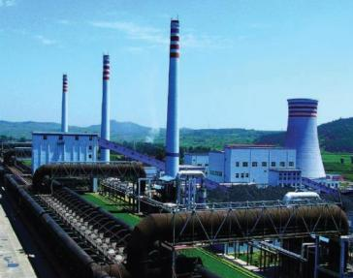
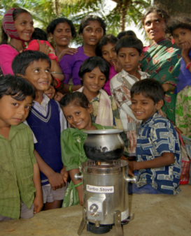
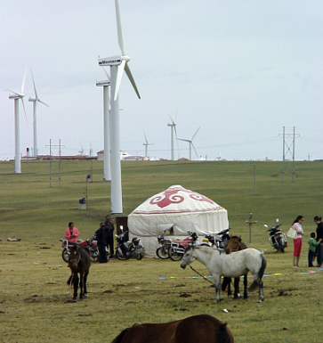
Expanding Engagement with the Private Sector on GEF Projects
Colombo, Sri Lanka
March 17-19, 2015

Slide 2
Expanding Private Sector Engagement
Private sector engagement is not new; but GEF projects can deliver more by partnering on sustainable business models and attracting more investment for environmental benefits
In GEF-6 we are pursuing:
  1. Mainstreaming - seeking private sector engagement in all projects
  2. Integrated Approach Pilots - targeted initiatives
  3. Non-Grant Instrument (NGI) - special set-aside for investments

Slide 3
Typical types of private sector actors for GEF projects
Type
Description/Examples
1
Capital providers
  Pension funds, VCs
2
Financial intermedi-aries and facilitators
  Investment banks, commercial banks, financial advisory services
3a
Industry players – large corporations
  Large retail, manufacturing companies, project developers, etc.
3b
Industry players – SMEs
  Full time staff below 250 or less depending on the country
3c
Industry players – individuals/ entrepreneurs
  Small start-ups with full time staff below 10

Slide 4
Benefits of Private Sector Engagement
The private sector can strengthen partnerships and make contributions to environmental and developmental solutions, such as:
1. Additional funding
2. Expertise/skills/knowledge
3. Innovation
4. Technology transfer
5. Phase out substandard products

Slide 5
Reflections on selected GEF projects in this region
We reviewed a few GEF projects to learn:
>
Was the private sector part of the problem and solution?
>
Is there an essential contribution of private sector stakeholders in the project?
>
What results or lessons learned can provide insights for future private sector engagement?
We used the GEF intervention models to review these projects

Slide 6





The GEF regularly uses five intervention models in this eco-system
1
Transforming policy and regulatory environments
2
Deploying innovative financial instruments
3
Convening multi-stakeholder alliances
4
Strengthening institutional capacity and decision-making
5
Demonstrating innovative approaches

Slide 7
Transforming policy and regulatory environments
SLM Offset in Western Mongolia
(GEF ID 5700) UNDP
Focal Area
Project Objectives
GEF
Private Sector
Land Degradation
Reduce negative impacts of mining on rangelands in the western mountain and steppe region
GEF grant helps create framework and conditions for SLM offset mechanisms and build capacity of mining on rangelands by incorporating mitigation hierarchy and offset for land degradation into the landscape level planning and management
Participation of mining companies in the design of SLM regulatory framework and offset mechanisms as well as in the rehabilitation of the degraded land and with co-financing
Best Practices/Lessons
GEF investment helped deliver appropriate regulatory framework on SLM and with the participation of the mining industry in the its design and implementation

Slide 8
Strengthening institutional capacity and decision-making
Implementing the Nagoya Protocol on Access to Genetic Resources and Benefit Sharing (GEF ID 5448) UNDP
Focal Area
Project Objectives
GEF
Private Sector
Biodiversity
Develop and implement a national Access and Benefit Sharing (ABS) framework, build national capacities and facilitate the discovery of nature-based products
GEF grant helped conclude an and ABS agreement between the country and private sector companies that fosters the involvement of the private sector in the exploitation of Bhutan’s natural resources that benefit the country
Private sector participation in the exploitation of Bhutan’s natural resources, co-financing and capacity building
Best Practices/Lessons
GEF investment was instrumental to the design and implementation of a PPP scheme that allowed the participation of the private sector to provide capacity building to the government and private sector in the exploitation of the country’s natural resources

Slide 9
Deploying innovative financial instruments
China Utility-Based Energy Efficiency Finance Program (CHUEE) (GEF ID 2624) World Bank
Partial Risk Sharing Facility for Energy Efficiency (GEF ID 4918) World Bank
Focal Area
Project Objectives
GEF
Private Sector
Climate Change
Reduce emissions of GHGs in the delivery of energy services in China by supporting implementation of energy efficiency (EE) projects
GEF’s grant used to support capacity building in the utility sector and policy reforms to demonstrate the application of the ESCO business model in China
Hard loans from local banks: Client companies installed efficiency equipment and contributed through equity investment
Climate Change
Expand local financing for energy efficiency in industry
The GEF provided support for targeted capacity building for government institutions and banks. Grant also contributes capital to risk-sharing facility.
Local banks provided hard loans partially protected from downside risk. Industries funded by the loans provide: Client companies installed efficiency equipment and contributed through equity investment
Best Practices/Lessons
GEF grant helped create market transformation in the energy efficiency sector in China
First of its kind risk sharing facility in India with blended government funding, CIF funding and GEF funding to create a risk guarantee facility to back banks invested in energy efficiency

Slide 10
Convening multi-stakeholder alliances
Finance Effective Management and Transitional Reform of Oceanic Fisheries (GEF ID 4856) FAO
Focal Area
Project Objectives
GEF
Private Sector
International Waters
To increase sustainable net economic benefits captured by small island developing states and costal developing countries from the more effective management and utilization of fisheries, while preserving or enhancing ocean biodiversity conservation
The GEF helped build efficiency and sustainability in tuna production and biodiversity conservation in the ABNJ through the systematic application of an ecosystem approach in tuna fisheries
Coastal states, in consultation with private sector actors and fishery communities, helped demonstrate the sustainability and net economic benefits of fisheries management model
Biodiversity
Best Practices/Lessons
An alliance of the project’s stakeholder helped align incentives for the successful implantation of the project. This alliance established and harmonized minimum standards along the supply chain for and to incentivize industry actors

Slide 11
Demonstrating innovative approaches
Promotion of Non-fired Brick (NFB) Production and Utilization(GEF ID 4801) FAO
Focal Area
Project Objectives
GEF
Private Sector
Climate Change
Promotion of Non-fired Brick (NFB) production and utilization to help reduce the annual growth rate of GHG emissions in Viet Nam
The GEF grant helped industry meet the manufacturing levels for non-fired bricks (requirements for the gradual replacement of clay-fired bricks with non-fired bricks in construction works)
Local construction firms benefited from increased access to NFB technology and
techniques.
Best Practices/Lessons
The demonstrations and financial aid provided by the GEF grant helped NFB manufacturers grow their market and overcome the lack of access to the NFB technology

Slide 12
Private sector engagement exercise
>
Would private sector engagement contribute to environmental benefits and my projects?
>
Identify specific actions to engage the private sector and include private sector in project design and implementation.
>
Think about who you would need to involve, through the project design, which agency, why.
>
Examples include 1) forestry: private sector alliances to help design lacking regulatory policies and 2) e-waste: corporate partners.

Slide 13
Publications

Slide 14
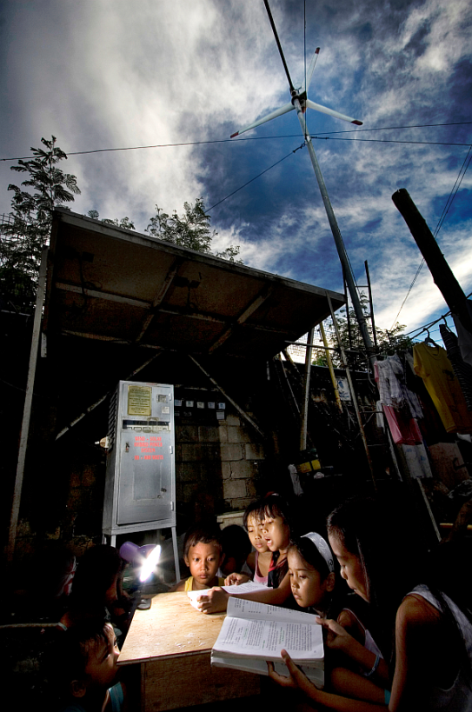
Your Questions or Ideas!
Contact your country support representative.
More information is also available at the following link: www.thegef.org/gef/ppp

