Slide 1


Slide 2

Agency Stakeholders
Global Environmental Facility (GEF)
United Nations Development Programme (UNDP)
United Nations Office for Project Services (UNOPS)
Notes:
GEF: – Financing; Chair of SGP Steering Committee
United Nations Development Programme (UNDP) – Implementing Agency; Co-financing
United Nations Office for Project Services – Executing Agency

Slide 3
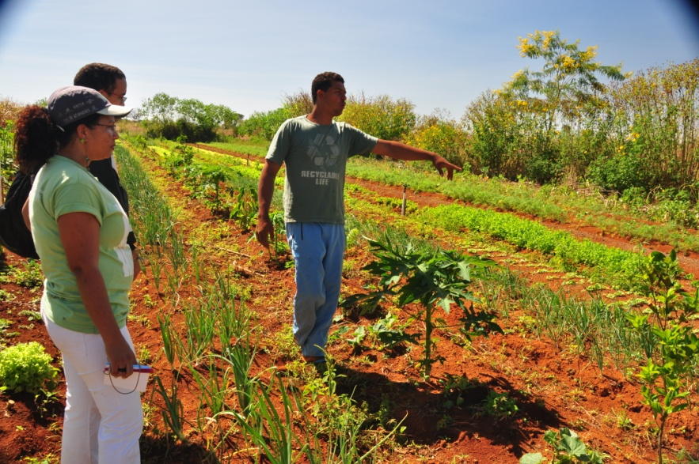

What is SGP?
A program, which:
Believes that local solutions to global environmental problems exist.
Supports community-based initiatives and action.
That the process of implementation leads also to poverty reduction and local empowerment.

Slide 4
Nature of SGP Grants
Planning grants: $2,500
Small grants projects: up to $50,000
Strategic grants: up to $150,000
Local CBOs, NGOs, communities, civil society organizations;
Review and approval of proposals done at country level through National Steering Committee
Notes:
From planning grants of $2,500 to full small grants projects of up to $50,000; average of $20,000; strategic grants up to $150,000
Grantees are local CBOs, NGOs, communities, civil society organizations; priority for poor and vulnerable communities – international NGOs can be partners giving support but not grantees
Projects must be prepared by and implemented by communities or civil society organizations (CSOs)
Projects must be within the GEF Focal Areas –
Release of funds direct to grantee bank account; direct agreement with community possible
Review and approval of proposals done at country level through the multi-sectoral National Steering Committee

Slide 5
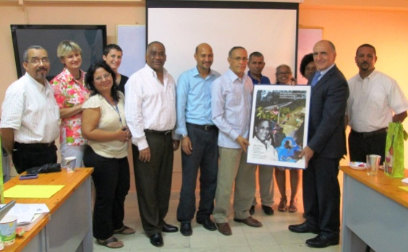
SGP Country Governance Structure
National Steering Committee (NSC):
Country driven
Capacity-building for CSOs
Review and approval of projects
Mobilize resources, link SGP to policy and planning
Majority non-governmental
OFP and UNDP CO are ex-officio
All volunteers of various expertise
Tenure 2 years; exceptionally renewable
Notes:
Selection is consultative facilitated by the SGP National
Coordinator and UNDP RR/RC
Final approval by SGP Global Manager at initial stage, by CPMT
in later stages

Slide 6
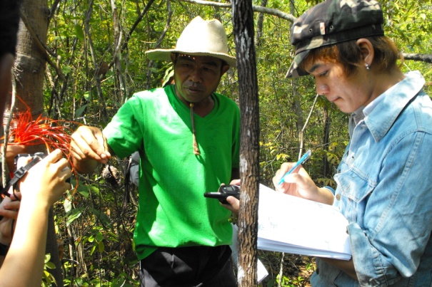
SGP Country Governance
Technical Advisory Group (TAG):
Get more involvement;
Expert review group;
NGO experts, academia, reps of Conventions
Focal Points;
Quality of proposals.
Notes:
Assure that proposals that get to NSC are well prepared and decisions of approval based on merit.

Slide 7
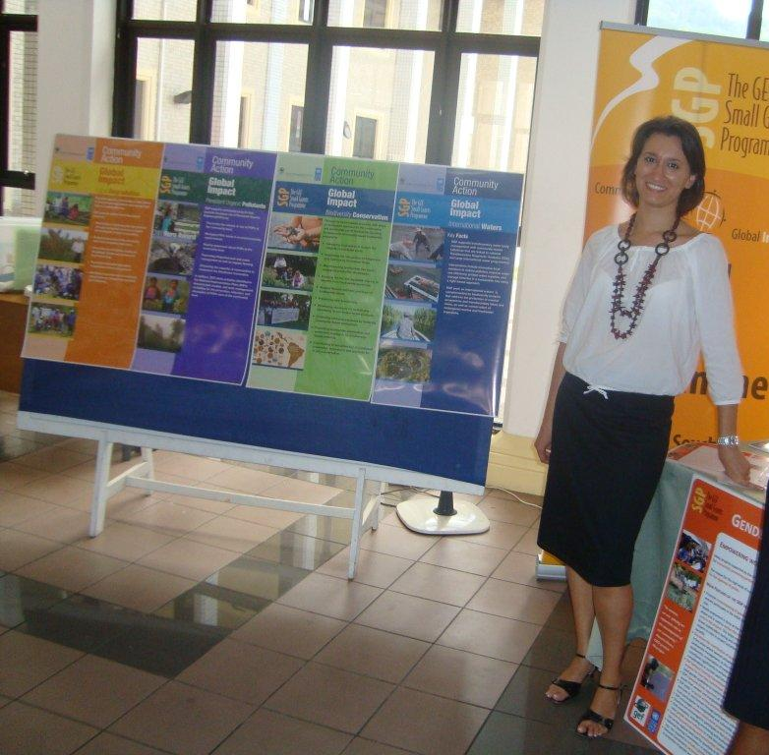
SGP Country Management
SGP Country Team:
National Coordinator (NC)
Competitively selected
UNOPS contracted
Implements decisions and policies of NSC
Primary supervisor is SGP Global Manager on programmatic matters.
Programme Assistant (PA)
Competitively selected and UNOPS contracted
Supports the NC and reports to the NC
Notes:
SGP Country Team:
National Coordinator (NC)
Competitively selected
UNOPS contracted
Implements decisions and policies of NSC
Primary supervisor is SGP Global Manager on programmatic matters; UNDP CO supervises on admin and adherence to UN professional and ethical standards
Programme Assistant (PA)
Competitively selected and UNOPS contracted
Supports the NC and reports to the NC

Slide 8
SGP Global Management
Central Programme Management Team (CPMT)
Provide guidance on meeting the commitments of SGP to GEF
Maintain global coherence
Raise global co-financing
Link country outcomes to global environmental governance
Global Manager and DGM plus focal area experts that also serve as Regional Focal Persons
SGP Steering Committee
GEF Secretariat (Chair), UNDP-GEF and the GEF CSO Network
Provides strategic guidance

Slide 9
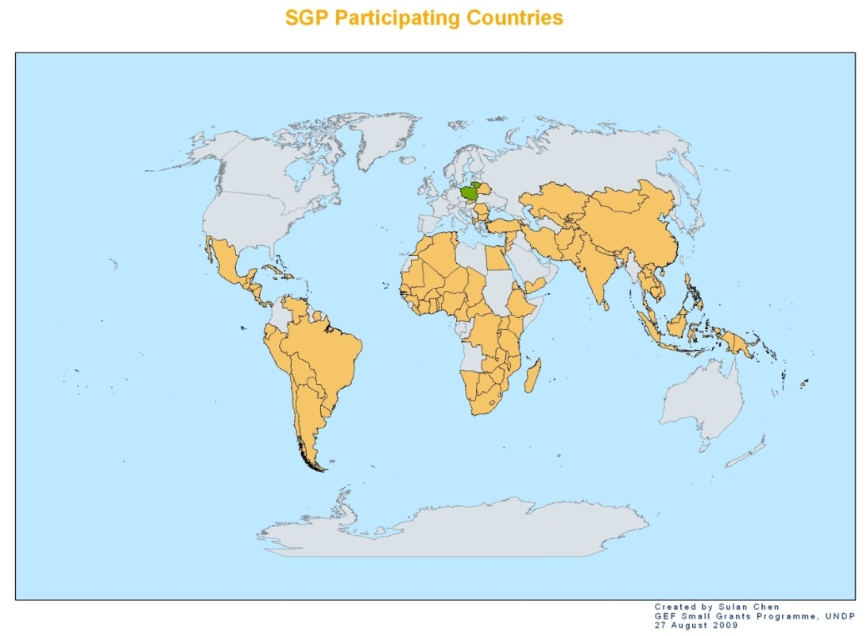
SGP as a Global Programme
22 new countries joined during OP4 (2008-2010)
8 new countries started up during 5th Operational Phase (OP5) from 2010-2014 for a total of 136
More than 19,000 projects globally
Notes:
In GEF-6, SGP will have a three-pronged approach
Focus on globally recognized ecosystems
Set up institutional and financial support mechanisms
Systematically develop the capacity of local and national civil society stakeholders.

Slide 10
Integration with National Efforts
Development of the Country Programme Strategy (CPS)
a. endorsed by the NSC and shared with the GEF OFP and
Convention Focal Points;
b. links with other planning and priority processes in the country
Involvement in NPFEs, NBSAPs, NAPAs, etc.
a. input SGP lessons learned
b. position CSO/community stakeholders into strategic roles
Linkages with MSPs/FSPs
Notes:
Development of the Country Programme Strategy (CPS)
a. endorsed by the NSC and shared with the GEF OFP and
Convention Focal Points;
b. links with the NBSAPs, NIPs, other National Communications to
Conventions, results of NCSAs, and GEF resources allocation
strategy; other relevant government and NGO projects and programs
Involvement in NPFEs, NBSAPs, NAPAs, etc.
a. input SGP lessons learned
b. position CSO/community stakeholders into strategic roles
Linkages with MSPs/FSPs

Slide 11
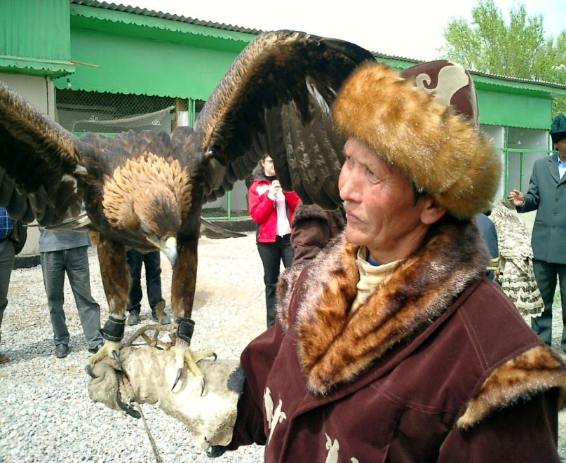
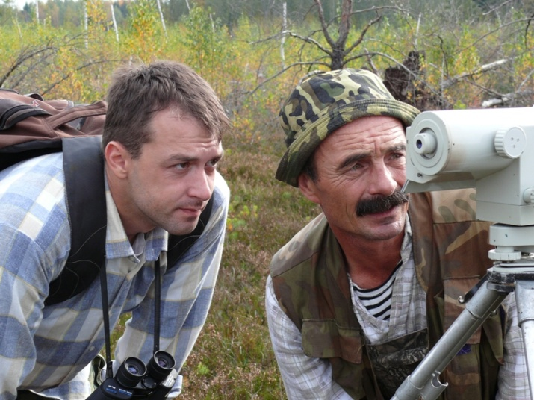
SGP OP6 Programming directions
In GEF-6, SGP will have a three-pronged approach
Focus on globally recognized ecosystems
Set up institutional and financial support mechanisms
Systematically develop the capacity of local and national civil society stakeholders.

Slide 12

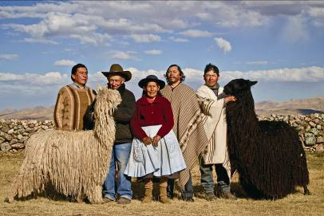
SGP OP6 Programming directions
For greater efficiency in the use of limited resources and to promote mainstreaming and scaling up, SGP country programmes can select from a set of four (4) multi-focal strategic initiatives:
Community Landscape and Seascape Conservation
Climate Smart Innovative Agro-ecology
Low Carbon Energy Access Co-benefits
Local to Global Chemical Management Coalitions

Slide 13

Partnerships
Grantees
National Governments
State/Local Governments
Regional Governments
Bilateral aid
Corporations
Multilateral agencies
Foundations
NGOs
Notes:
UNDP
UNEP
UNV
World Bank
European Commission
New Zealand Aid
AusAID
United Nations Foundation
Government of Japan
German Government
Swiss Agency for Development and Cooperation
ASEAN Center for Biodiversity
National Environmental Funds
International NGOs (RSBP/Birdlife, etc.)
ICRAN
IPEN
Women’s Groups
British Petroleum, Coca-Cola, Expedia
Development Bank of Southern Africa, HSBC
Hotel Associations

