Slide 1
System for Transparent Allocation of Resources: STAR
GEF Expanded Constituency Workshop
Colombo, Sri Lanka
March 17-18, 2015

Slide 2
Background
The current mechanism by which GEF resources are allocated to countries in three focal areas – Biodiversity, Climate Change, and Land Degradation
The Resource Allocation Framework (RAF) was the first PBA for the GEF and adopted for GEF-4
The STAR updated the RAF and was implemented for GEF-5
The STAR was recently updated for GEF-6

Slide 3
Objectives
STAR aims to allocate scarce GEF resources within and among focal areas in order to:
maximise impact on the global environment
promote sound environmental policies and practices
meet convention requirements
match country driven priorities

Slide 4
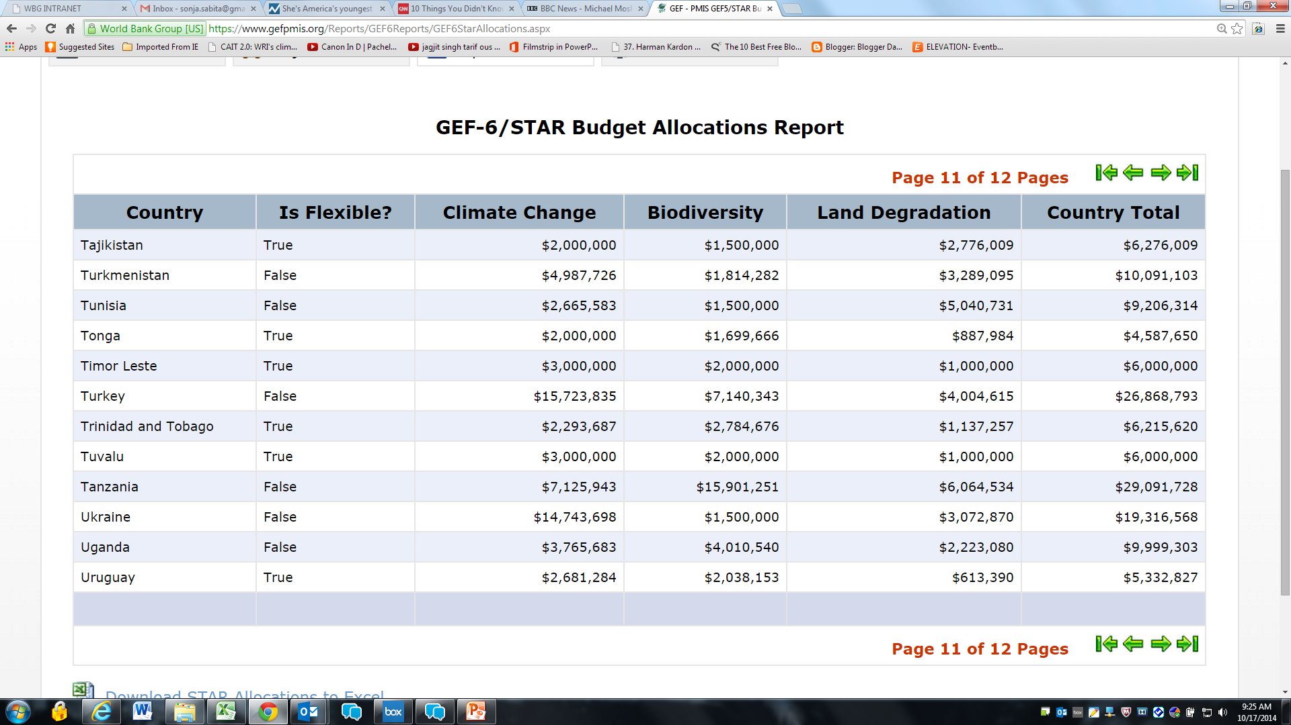

Slide 5
Calculating STAR allocations
1
Determine Available Focal Area Funds
2
Calculate “Country Scores”
3
Calculate Preliminary Country Allocations
4
Adjust for Floors and Ceilings
5
Obtain Final Allocations
6
Determine post-allocation Flexibilities

Slide 6
Available Focal Area Funds
Total Envelope
Focal Areas
less Set Asides
Country Allocations
STAR Focal Areas

Slide 7
The main indices
Global Benefits Index: measures a country’s relative share of GEF potential benefits that can be generated by a fixed amount of resource input into a focal area
Country Performance Index: measures a country’s performance and capacity to deliver potential global environmental benefits
GDP Index: designed to increase allocation of countries with a low GDP per capita

Slide 8
The country score
COUNTRY SCORE
Global Benefits Index
Country Performance Index
GDP Index
Biodiversity
Climate Change
Land Degradation
Country Score = GBI^{0.8} CPI ^{1.0} GDP^{-0.08}

Slide 9
Preliminary country allocations
Country Share =
Country Score / Sum of Country Scores for all eligible countries
Preliminary Allocation =
Country Share * Available Focal Area Funds

Slide 10
Floors and Ceilings
Focal Area | Floor for LDCs | Floor for Non LDCs | Ceiling % | Ceilings (US Mn)
Climate Change | 3 | 2 | 10% | 126
Biodiversity | 2 | 1.5 | 10% | 129.6
Land Degradation | 1 | 0.5 | 10% | 43.1

Slide 11
Final allocations
Adjustments for floors and ceilings mean there is a surplus or deficit relative to the preliminary allocation
This is then allocated among countries using the country scores
Process iterates until the full amount has been allocated among countries

Slide 12
Flexibilities and marginal adjustment
Flexibilities relate to the utilization(not allocation) of GEF resources
Countries are allowed to adjust their focal area allocations (but not their total envelope)
Total Allocation X | Allowed Marginal Adjustment
X ≤ 7 million | unlimited
X > 7 million | 2 million

Slide 13
Approximate Calculation: Trinidad and Tobago
 | BIODIVERSITY | CLIMATE CHANGE | LAND DEGRADATION
GBI | 0.21 | 0.12 | 0.30
CPI | 3.65
GDPI | 17934.06
COUNTRY SCORE (GBI^{0.8} CPI ^{1.0} GDP^{-0.08}) | 0.48 | 0.306 | 0.63
SUM OF COUNTRY SCORES | 174.45 | 147.30 | 189.39
COUNTRY SHARE | 0.002753 | 0.00208 | 0.00333
FOCAL AREA ALLOCATION | 1051 | 941 | 346
PRELIMINARY COUNTRY ALLOCATION | 2.89 | 1.96 | 1.15
FINAL COUNTRY ALLOCATION | 2.78 | 2.29 | 1.14
TOTAL ALLOCATION = 6.22 MILLION (FULLY FLEXIBLE COUNTRY)

Slide 15
GEF 6 STAR Allocations
Country | CC | BD | LD | Total | Flexible
Bangladesh | 7.29 | 2 | 1.05 | 10.35 | No
Bhutan | 3 | 2.02 | 1.12 | 6.14 | Yes
Cambodia | 3.00 | 4.29 | 1.31 | 8.59 | No
China | 126 | 58.55 | 9.95 | 194.50 | No
India | 87.88 | 36.87 | 5.83 | 130.58 | No
Lao PDR | 3.07 | 6.87 | 1.63 | 11.58 | No
Malaysia | 11.04 | 14.92 | 1.31 | 27.27 | No
Maldives | 3.00 | 2.66 | 1.00 | 6.66 | Yes
Mongolia | 3.02 | 5.09 | 3.65 | 11.76 | No
Myanmar | 16.95 | 10.98 | 2.34 | 30.26 | No
Nepal | 3.60 | 3.34 | 1.96 | 8.90 | No
Sri Lanka | 2.00 | 7.12 | 1.92 | 11.04 | No
Thailand | 14.89 | 10.26 | 2.69 | 27.83 | No
Vietnam | 11.36 | 13.17 | 1.52 | 26.05 | No
Notes:
This slide is modified depending on the workshop

Slide 16
Thank You
Sonja S. Teelucksingh
+1 202 458 84004
steelucksingh@thegef.org

