Slide 1
Results Based Management at the GEF
GEF Expanded Constituency Workshop

Slide 2
Presentation Overview
Results Based Management at GEF
Project Level Results
Portfolio Level Results
Tracking Tools and Lessons
Data Access and Transparency
Management Effectiveness & Efficiency
Reporting
Notes:
Results-based approach at the GEF (RBM)
Results at the GEF Project Level
Results at the GEF Portfolio Level (Monitoring)

Slide 3
Results Based Management at the GEF

Slide 4
Results-Based Management: Definition
A results-based approach aims to improve management effectiveness and accountability by “defining realistic expected results, monitoring progress toward the achievement of expected results, integrating lessons learned into management decisions and reporting on performance.”
Canadian International Development Agency (CIDA), 1999

Slide 5
Tracking Results
Project Design
Implementation
Evaluation
LFA/Results framework
M&E Plan
Monitoring of progress; midpoint course correction as needed
Terminal Evaluations
Lessons Learned
Management, monitoring, and learning
Lessons learned; Good practices
Adapted from the World Bank’s Results Focus in Country Assistance Strategies, July 2005, p. 13
Notes:
At the project design phase all projects must include a Logical Framework Analysis (LFA)/Results framework with specific output and outcome indicators that align with the GEF focal area strategic programs. Breaking down the project cycle into three phases (project design, implementation, evaluation), highlights the learning and management aspect of the RBM framework.

Slide 6
Menu
Global Environmental Benefits
Strategic Goals
Management Effectiveness & Efficiency
Recipes
Focal Area Goals
and Objectives
Project and Portfolio Performance
Targeted Learning &
Information Accessibility
Ingredients

Slide 7
Alignment of Focal Area Objectives to Strategic Goal
Each focal area’s goals and objectives align with GEF Strategic Goals
Project level goals align with focal area objectives
Example:
BD Objective: Improved sustainability of protected area systems
Strategic Goal 1: Conserve, sustainably use, and manage biodiversity, ecosystems and natural resources globally
CC Objective: Promote the demonstration, deployment, and transfer of innovative low-carbon technologies
Strategic Goal 2: Reduce global climate change risks by stabilizing atmospheric GHG concentrations through emission reduction actions

Slide 8
GEF RBM Framework
Institutional Level
(top-down)
GEF Strategic Goals
GEB
Impacts
Outcomes
Outputs
Focal Area Goal
Focal Area Objectives
Operating Level
(bottom-up)
Project Objectives
Notes:
Each level of the pyramid is connected to the other in both an upward and downward direction. In this model the starting point for a monitoring system is a project’s logical/results framework (logframe). The logframe approach (LFA) is not new but it is still useful because it is built on the planning concept of a hierarchy of levels that link project inputs, activities, outputs, outcomes, and goals. A cause-and-effect relationship is assumed, with elements at the lower level contributing to the attainment of those above.
At the highest level of RBM is the institution as a whole. The lower levels contribute towards achieving the overall goal of the GEF. In the GEF Instrument, the GEF operates “as a mechanism for international cooperation for the purpose of providing new and additional grant and concessional funding to meet the agreed incremental cost of measures to achieve agreed global environmental benefits,” in six focal areas. The longer-term expected impact of achieving “global environmental benefits” at an institutional level cannot be monitored on a consistent, periodic basis. If, however, the GEF monitors how outputs and outcomes at the project and program level are progressing towards achieving global environmental benefits, a more in-depth study, analyzing causes and effects of GEF interventions can more accurately be carried out by an evaluation. In other words, the RBM system is part of a process intended to equip the GEF with the information needed to assess how the GEF interventions contribute toward its overall goal.
Three results levels: project, focal area or portfolio-level, and corporate-level. The GEF Secretariat is responsible for measuring results at the focal area or portfolio-level and at the corporate-level. GEF Agencies will ensure the measurement of results at the project-level

Slide 9
Project Level Results

Slide 10
Indicators
“A quantitative or qualitative factor or variable that provides a simple and reliable means to measure achievement, to reflect changes connected to an intervention, or to help assess the performance of a development actor”
-- OECD /DAC 2002

Slide 11
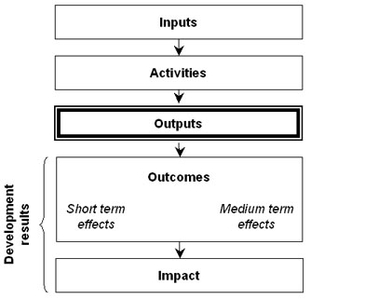
OECD DAC Results Chain
Notes:
OECD DAC Glossary of Key terms in Evaluation and Results-Based Management:
Inputs: The financial, human, and material resources used for the development intervention
Activities: Actions taken or work performed through which inputs, such as funds, technical assistance and other types of resources are mobilized to produce specific outputs
Outputs: The products and services which result from the completion of activities within a development intervention.
Outcome: The intended or achieved short-term and medium-term effects of an intervention’s outputs, usually requiring the collective effort of partners. Outcomes represent changes in development conditions which occur between the completion of outputs and the achievement of impact.
Impact: Positive and negative long-term effects on identifiable population groups produced by a development intervention. These effects can be economic, socio-cultural, institutional, environmental, technological or of other types.
Results: Changes in a state or condition which derive from a cause-and- effect relationship. There are three types of such changes which can be set in motion by a development intervention – its output, outcome and impact.
Goal: The higher-order objective to which a development intervention is intended to contribute.

Slide 12
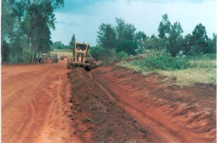
Inputs : Funds for road construction, equipment & staff
Activities : Construction of road
Outputs: Improved road
Outcomes: Travel time
reduced, more products sold
Impact: Trade activities improved, household income increased
Adapted from World Bank Module 2 Results Chain, Europe and Central Asia Region, 2007
Notes:
Outcomes: as well as (farmers & manufactures have better access to market)
Sample indicators for this example:
Outputs: KM of road paved
Outcomes: average travel time from point A to point B
Impact: household income (local currency)
You would get the baseline at the beginning of the project and measure throughout the project to monitor progress

Slide 13
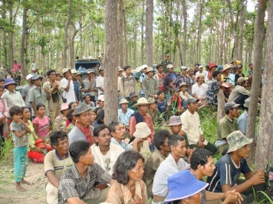
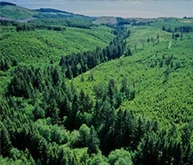
Inputs: GEF and co-finance resources
Activities: Allocate forest land to local communities to manage with appropriate sustainable forest management policies;
Outputs: ha of forest under community sustainable forest management
Outcomes: ha of improved forests
Impact: Sequestration of carbon and biodiversity conserved
Notes:
Example from a “simplified” environment project (i.e. I have only taken one activity, all projects contain many more than just this)
Ha = hectares

Slide 14
Baselines
Initial data on project participants or other project aspects collected prior to the project intervention
When baseline data are not available it is difficult to:
Set future targets of the project
If you do not know where you are, how can you know where you are going?
Estimate changes as a project proceeds in monitoring
Compare the initial conditions and changes of project in an evaluation

Slide 15
Baselines for GEF Projects
Must be in place by CEO Endorsement/ approval
If there is not a baseline figure for every indicator → a plan must be outlined as to how to capture baseline during first year of implementation

Slide 16
Portfolio Level Results

Slide 17
Portfolio Monitoring
Monitoring the entire set of interventions funded by the GEF
Secretariat's Monitoring Focused on Overall GEF Portfolio
Global Environmental Benefits
Focal are expected outcomes
Notes:
Portfolio Monitoring at both the focal area and corporate-level is based on the indicators and targets set out in each Focal Area results framework and the GEF Strategic Results Framework (GEF-5 programming document).
The Secretariat in coordination with the GEF Agencies implement a consistent and integrated RBM approach with the introduction of organization-wide strategic goals. GEF’s results monitoring at the portfolio level identifies and measures outcome results achieved during the project life rather longer-term impacts, which are better captured through
evaluations.
GEF results monitoring will focus on the measurement of outcomes and core outputs. Immediate outcomes, core outputs and other measures of performance are good proxies for progress towards achieving higher-level results. Implementing Agencies will be responsible for project level results measurement and reporting.

Slide 18
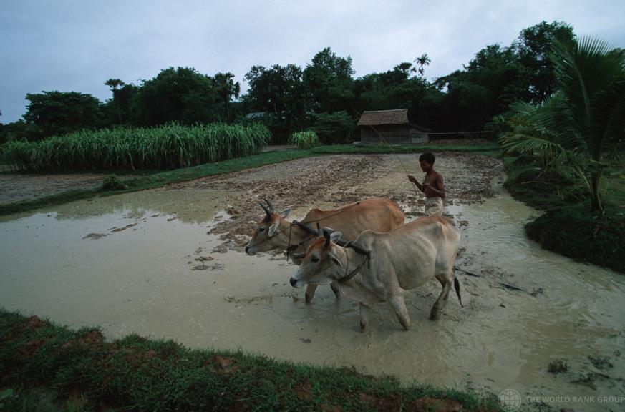
Source: Global Environment Facility
Climate Change:
Green House Gas (GHG) emissions reduced
Notes:
DID YOU KNOW that 80% of Cambodia’s population live in rural areas, vulnerable to floods, droughts and other climate change-related phenomena?

Slide 19
Source: Global Environment Facility
Biodiversity:
ha of protected area (PA) supported
Notes:
Cape Floral Regions PA – South Africa

Slide 20
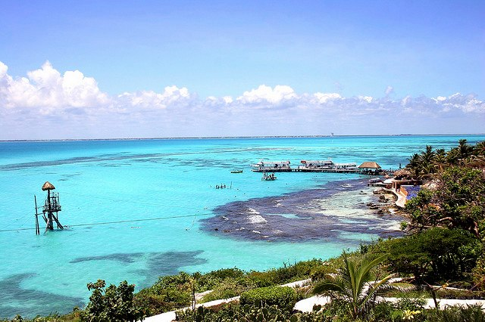
Source: Global Environment Facility
International Waters:
No. of strategic partnerships funded to produce measurable pollution reductions in water bodies
Notes:
DID YOU KNOW that groundwater is especially valuable because it does not normally require chemical treatment?

Slide 21
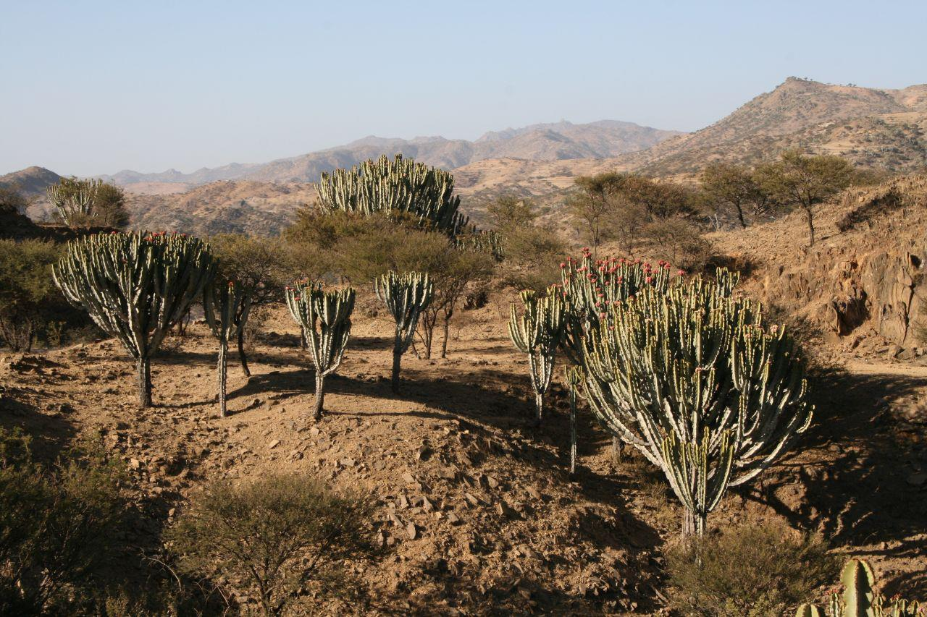
Source: Global Environment Facility
Land Degradation:
ha brought under sustainable land management (SLM)
Notes:
DID YOU KNOW that land degradation is a severe problem in the Central Highland Zone of Eritrea?

Slide 22
BD Focal Area Objective | Outcome | Indicator - Outcome | Indicator - Output
Improved sustainability of protected area systems | Increased revenue for protected area systems to meet total expenditures required for management | Total annual revenue is sufficient for management of protected area | Total annual revenue- $ Sustainable financing plans (No.)
CC Focal Area Objective | Outcome | Indicator - Outcome | Indicator - Output
Promote the demonstration, deployment, and transfer of innovative low-carbon technologies | Technologies successfully demonstrated, deployed, and transferred | Percentage of technology demonstrations reaching planned goals | Innovative low-carbon technologies demonstrated and deployed on the ground (No.)

Slide 23
Tracking Tools and Lessons Why? What? When?
Tracking Tools and Lessons
Why? What? When?

Slide 24
Purpose of the GEF Tracking Tools (why?)
To measure progress in achieving the impacts and outcomes established at the portfolio level under each focal area
Demonstrates progress made against indicators common to all projects
can also reveal shortcomings
Helps to guide and inform project implementation
Provides justification for continued investment in each focal area programming
Notes:
Text in box was taken directly from GEF-5 TT Guidelines (April 2011)
Make the case for the thorough and consistent application of GEF TT

Slide 25
Purpose of the GEF Tracking Tools (why?)
Project data is aggregated for analysis of directional trends & patterns at a portfolio-wide level to inform the development of future GEF strategies and to report to GEF Council on portfolio-level performance in each focal area
TTs are GEF Portfolio monitoring tool (a portfolio performance tool)
Allows for aggregation of results at the global level
TTs are intended:
To roll up indicators from the individual project level to the portfolio level
To track overall portfolio performance in focal areas
Aggregated results are then published by the GEF in the Annual Monitoring Report (AMR), shared with donors
Notes:
Text in organge box was taken from GEF-5 TT guidelines, though is slightly abridged.
The Annual Monitoring Review (AMR), the principal reporting tool of the GEF, provides an annual snapshot of the overall state of the GEF’s active portfolio.

Slide 26
Summary of GEF TT requirements (When?)
Each focal area has its own tracking tool to meet its unique needs
TTs must be complete at CEO Endorsement for FSPs or CEO approval for MSPs
TTs submitted again at mid-term and project completion
TT & their associated guidelines can be found: http://www.thegef.org/gef/tracking_tools

Slide 27
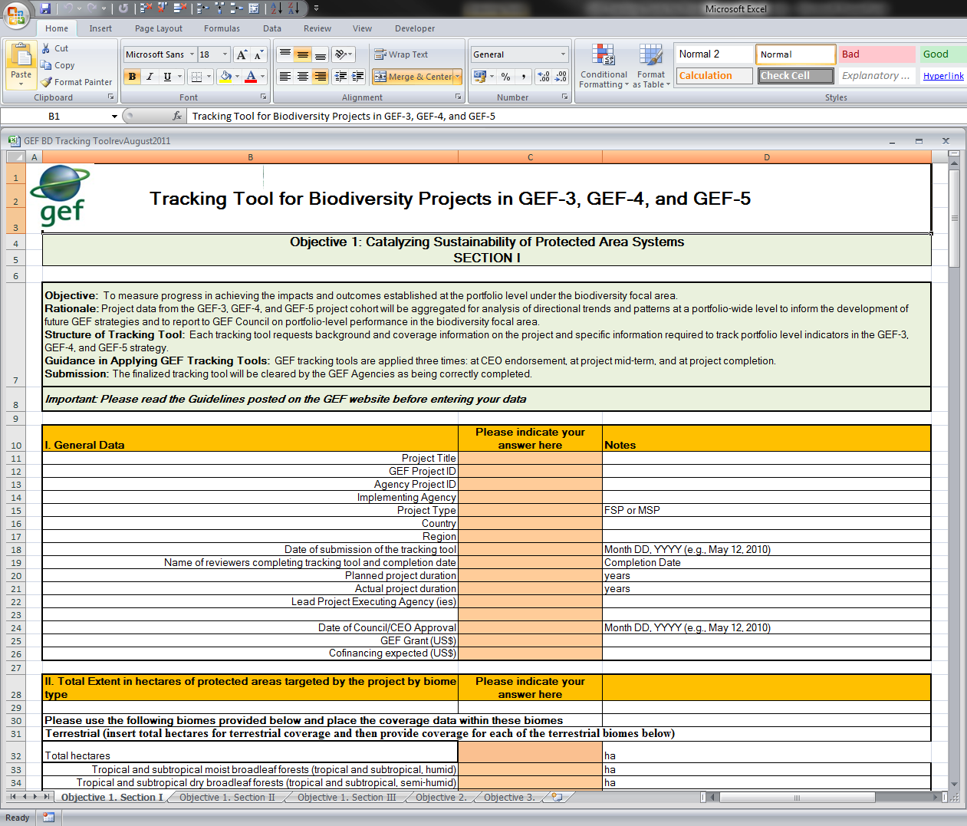
Structure of the GEF Tracking Tools (What?)
Sample of Biodiversity TT spreadsheets:
Objective 1. Section I
Objective 1. Section II
Objective 1. Section III
Objective 2.
Objective 3.
Protected
Areas
Mainstreaming
Biosafety
Notes:
Make the point that the project should complete only the TTs specific to its objective. State what TTS those are.
Sheets of the TTs not required of a project can and should be deleted from the template.

Slide 28
Reporting, Data Access & Transparency
Data Access & Transparency

Slide 29
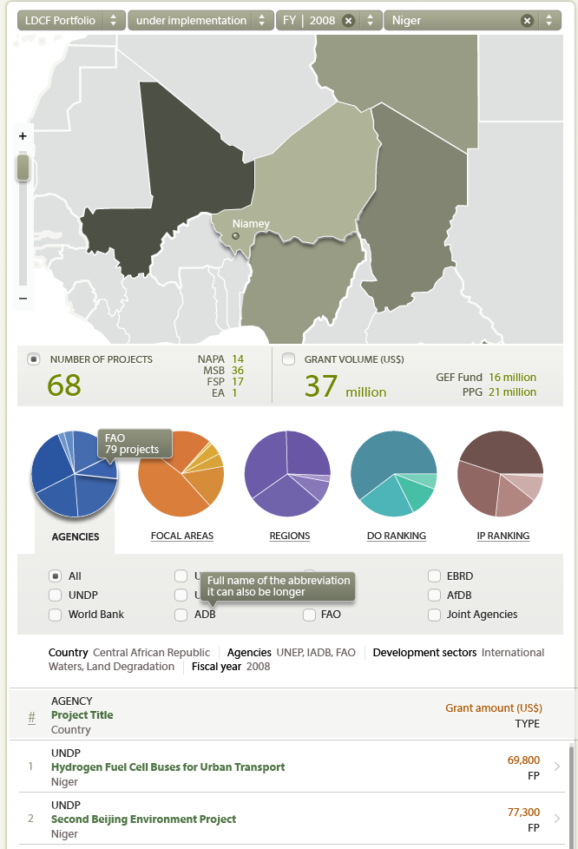
Mapping Portal to Access and Sort Data
Next Step: Progress toward Results (outcomes & outputs) Captured through Mapping Portal
Notes:
A web-based interactive map developed using the data received through the Annual Monitoring Review (AMR) process.

Slide 30
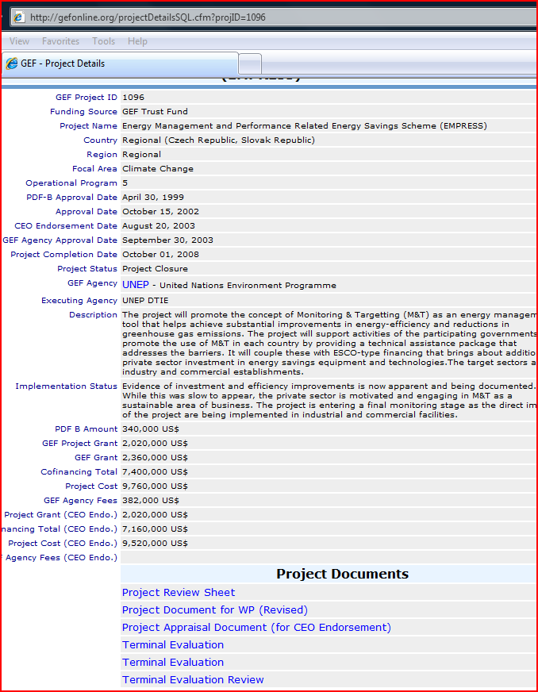
The Web-mapping portal,
links directly to the GEF
online project database.
Public Availability of Project Reports (PIRs, TTs, MTRs & TEs ) through the Mapping Portal

Slide 31
Questions about the GEF Tracking Tools
What benefits do the GEF Tracking Tools bring to individual projects?
What benefits do the GEF Tracking Tools bring to countries?
What benefits do the GEF Tracking Tools bring to GEF Agencies?
Notes:
METT = management effectiveness scorecard
FSC = financial sustainability scorecard
Namibia , India and Zambia have all adopted the METT for their PA systems, after UNDP supported GEF funded biodiversity projects. Other countries are considering doing the same.

Slide 32
For more information:
http://www.thegef.org/gef/RBM
Contact us at RBM:
Dr. Omid Parhizkar: oparhizkar@thegef.org

