Slide 1
Chemicals Update
GEF Expanded Constituency Workshop
30 October to 1 November 2012
Arusha, Tanzania

Slide 2
GEF Chemicals -Background
The GEF provides resources to the following areas related to chemicals management
Phase out of Persistent Organic Pollutants – Stockholm Convention
Phase out of Ozone Depleting Substances (ODS), specifically to countries with economies in transition – Montreal Protocol
Pilot activities on mercury – to support and inform ongoing negotiations of an agreement on Mercury
Pilot activities on chemicals (and chemical issues) of global concern – related to the objectives of the Strategic Approach to International Chemicals Management (SAICM)
Notes:
GEF is the Interim Financial Mechanism of the Stockholm Convention on Persistent Organic Chemicals. Currently 22 Chemicals are controlled by the Convention. The first action of Parties is to develop a National Implementation Plan (NIP) that describes the actions and priorities the Party will undertake to address POPs. The GEF has funded 138 parties so far for these NIPs. Parties have submitted projects post NIP to implement capacity building to manage POPs and phase out POPS, including DDT, PCB, Dioxins and Furans and Agricultural POPS.
The GEF is not a Financial Mechanism of the Montreal Protocol. The majority of countries are funded by the Multilateral Fund for their ODS phase out, however when the Protocol was created, the USSR was a party and they were supposed to phase out their ODS by themselves. When the USSR broke up, the resulting CEITS inherited the Montreal Protocol Classification of the USSR and so were not eligible for MLF funding. The GEF Council stepped in to assist these countries and continue to do so.
Mercury is an elemental substance and is highly toxic. Countries are currently negotiating a new agreement on Mercury through an intergovernmental negotiating committee (INC). The GEF supports this process by providing funding to countries to examine specific issues related to the potential convention. Projects include storage of mercury (note that as an element, mercury cannot be destroyed and has to be safely stored – much the same as nuclear waste). The INC has met 3 times and at the 3rd meeting discussions on a Financial Mechanism has started. The GEF put forward its position on this at that meeting.
The Strategic Approach to International Chemicals Management is an overarching set of principles that seek harmonizing chemicals and waste management. The SAICM has a voluntary funding mechanism called the Quick Start Program (QSP) which funds projects up to 250K for countries to do activities such as developing chemical profiles, reviewing or developing national legislation or policy etc. The GEF independently has included funding in GEF 5 to explore issues such as e-waste, lead in paints and chemicals of global concern in products.
The SAICM is an output of the International Conference on Chemicals Management (ICCM) and seeks to cover the gaps in the three Chemical Conventions. Under the QSP developing countries and countries with economies in transition are eligible and can access funds once they officially communicate to the SAICM Secretariat a designated national focal point.

Slide 3
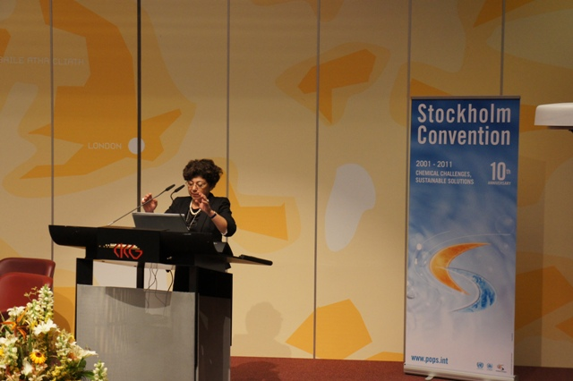
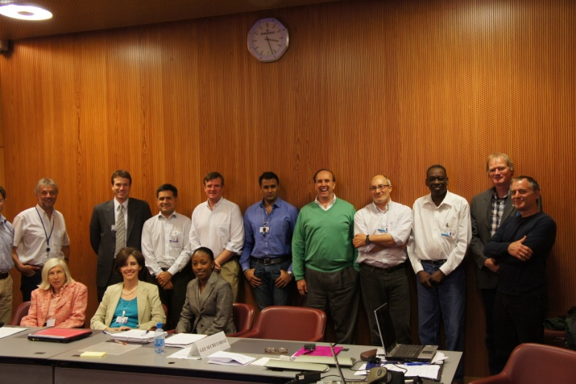
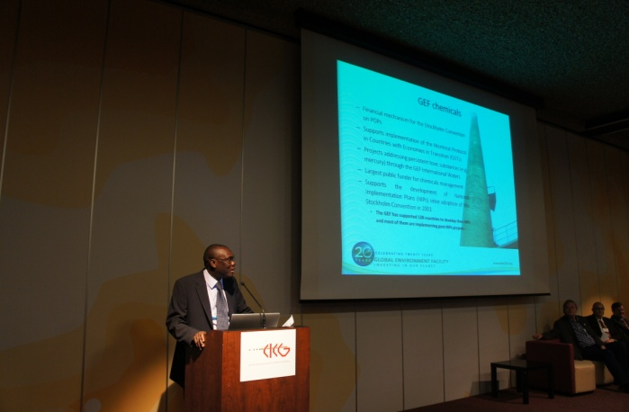
GEF 5 Highlights
88M in GEF investments plus an additional 489M in other resources to chemicals.
Approved 2 pilot projects on mercury reduction, one on artisanal gold mining and the other in health care sector.
Approved National Implementation Plan (NIP) updates both through agency access and direct access and we encourage all eligible Parties to continue to submit applications for NIP updates.
Completed the endorsement of the Russia chlorofluorocarbon (CFC) phase out in the metered dose inhaler sector.
Notes:
Up to the end of GEF 4 investments in Chemicals is 450M plus 700M in co-financing. GEF 5 has an allocation of 375M for POPs, 15M for Mercury, 25M for ODS and 10M for Sound Management of Chemicals. We have programmed so far 88M plus 489M in Co-financing.
The Mercury Projects approved are: Improve the Health and Environment of Artisanal and Small Scale Gold Mining (ASGM) Communities by Reducing Mercury Emissions and Promoting Sound Chemical Management – A regional project in Africa implemented by UNIDO (Burkina Faso, Mali and Senegal) and A Mercury Inventory and management system within the following project approved for Kazakhstan - NIP Update, Integration of POPs into National Planning and Promoting Sound Healthcare Waste Management in Kazakhstan.
The approved NIPS are Kenya through direct access and Kazakhstan through agency access. The following proposal for NIP Updates under direct access are being reviewed – Uganda, Mali and Senegal. Macedonia has applied through agency access (UNICO)
Metered Dose Inhalers (MDIs) are used for asthma and COPD treatment. The propellant in them was CFC. These need to be replaced with HFC. The projects in this sector helps companies reformulate the product and modify the delivery mechanism of the devices which requires both technology transfer and technical assistance.

Slide 4
Persistent Organic Pollutants
The majority of projects in GEF will be to implement the National Implementation Plans’ priorities, including reduction Polychorobiphenyls (PCBs), POPs pesticides, DDT (dichlorodiphenyltrichloroethane) and unintentionally produced POPs (U-POPs)
In GEF 5 Parties are encouraged to apply for funding (up to a maximum of 250K) to review and update their National Implementation Plans
There is an opportunity to submit demonstration/pilot activities addressing new POPS.
Notes:
PCB projects are usually in the Electricity generation and transmission sector. Typical projects include doing a detailed inventory of PCBS contained in equipment in use and equipment not in use, developing an environmentally sound management plan for the in use equipment and safe handling, interim storage and final disposal of PCBs in stockpiles and end of life equipment. Projects can also include replacement of equipment. Contaminated equipment and soil is also included in projects. While PCB is included in the list of Unintentionally Produced POPs (U-POPS), we have not had projects that addresses unintentional releases of PCBs. Equipment that contains PCBs include transformers and capacitors used in electricity generation and transmission. It is also found in the ballasts in old fluorescent bulbs, refrigerators, some types of paints etc. They are/were used when there was the need to have an electirc insulator.
Pesticide projects usually involve re-packaging, safe storage and disposal of pesticide stockpiles. Obsolete Stocks of DDT used as pesticide are included in these projects.
DDT projects typically focus on looking at alternatives for DDT in vector control. DDT use is not prohibited under the convention as long as countries have an exemption from the Convention, however they need to over the long term reduce and eliminate the use of DDT by finding suitable, chemical and non-chemical alternatives.
COP 4 added nine new Chemicals to the initial 12,and COP 5 added one more. Under the Convention this triggers an update of National Implementation Plans. There is up to a maximum per country of 250K for this purpose and countries can access either through direct access or agency access. So far 5 countries have applied via direct access (Kenya is already approved) and three others have applied via agency access (Kazakhstan has its NIP update approved with a larger FSP)

Slide 5
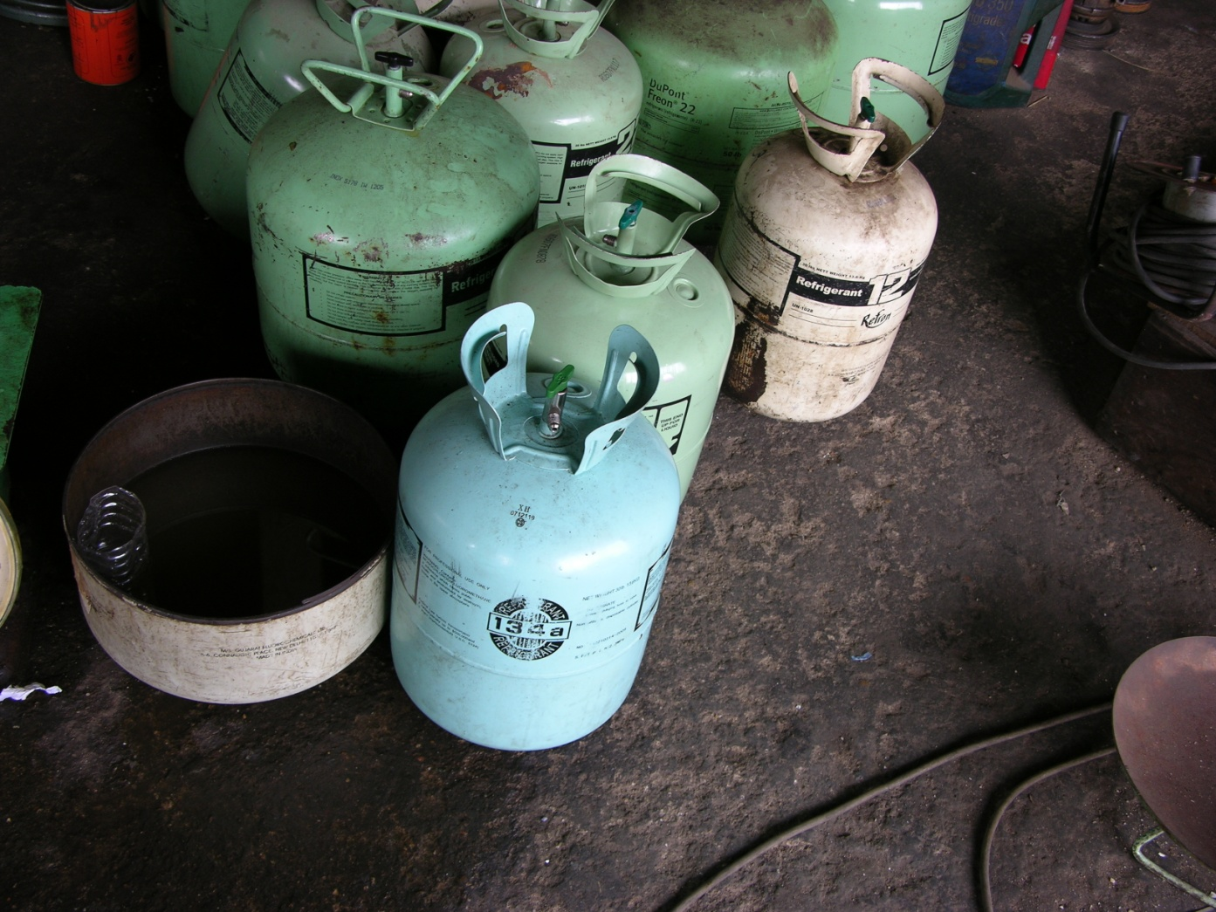
GEF supports the Montreal Protocol
GEF supports implementation of the Montreal Protocol (MP) in countries with economies in transition (CEITs). GEF5 has an allocation of 25M for the phase-out of Ozone Depleting Substances (ODS).
GEF has invested 232M for ODS phase-out in CEITs countries. GEF financed ODS phase out in Russia and CEITs, which is roughly equivalent to amounts phased out in all developing countries.
The GEF continues to support eligible CEITs on achieving phase out of hydro chlorofluorocarbons (HCFC) and methyl bromide.
Notes:
The GEF has funded the phase out of CFC in the CEITS. We are now investing in the phase out of HCFCs in these countries. The main applications of HCFCs are in the heating and cooling sector, refrigeration, industrial solvents, insulation foams, fire-fighting agents.

Slide 6
GEF funding for Mercury INC process
“GEF 5 mercury resources are intended to support assessment and pilot activities that will advance the development of the global mercury instrument and improve countries’ abilities to implement the its provisions when the (mercury) instrument enters into force. ”
- GEF Strategy for Mercury Programming
GEF5 has an allocation of 15M for activities related to pilot mercury reduction.
GEF has contributed to all mercury INCs.
Projects should address one or more of the following issues:
Reducing mercury use in products
Reducing mercury use in industrial processes
Reducing mercury use and exposures in artisanal and small-scale gold mining
Enhancing capacity for mercury storage
Reducing atmospheric emissions of mercury
Improved data and scientific information at the national level
Enhancing capacity to address waste and contaminated sites

Slide 7
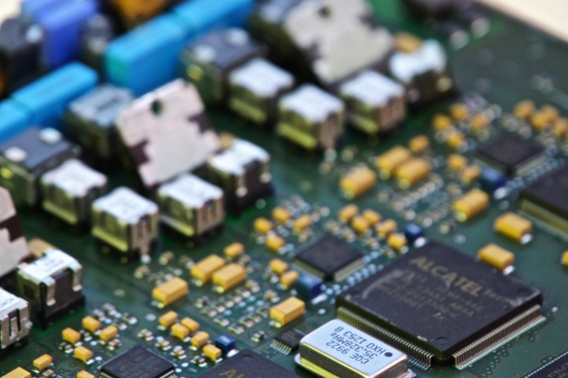
GEF funding for Chemicals Management
GEF5 has an allocation of 10M for sound chemicals management to cover the following issues:
E-waste – properly designed e-waste projects should take into account mercury and POPs issues as relevant.
Products containing chemicals of global concern, consistent with Strategic Approach to International Chemicals Management (SAICM)
Lead in paint
Notes:
E-waste covers a range of consumer and other products. It can range from mobile phones, to computer, refrigerators, stoves, microwave ovens etc. Once there is a chip in it is can be considered e-waste. Proper handling of this waste is necessary due to the hazardous chemicals in them included POPs. Mercury and lead, however significant revenues can be generated from proper recycling of these wastes. There are precious metals, recyclable plastics, copper etc that have a high resale value.

Slide 8
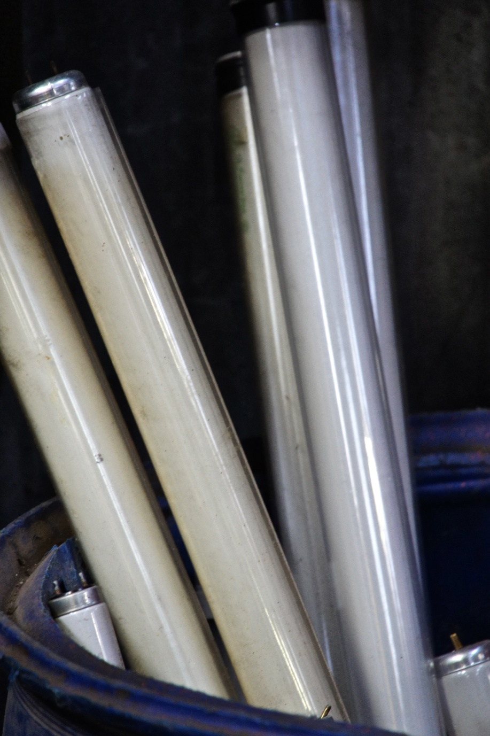
Finding Synergy in the Chemicals Portfolio
In GEF 5 more synergy in projects is encouraged in order to achieve greater impact.
In this regard, multi focal area, or multi-chemical projects that countries may wish to consider would include:
Dealing with POPs, e-waste, mercury, lead and improving waste management.
Mercury lamps and other waste products in building/lighting efficiency projects
Projects that seek to improve energy efficiency in the heating/cooling/air-conditioning production and consumption sector and phase out of ODS.
Mercury and POPS reduction in medical waste
Projects that incorporate action on Basel, Rotterdam and Stockholm Conventions.
POPs and ODS co- destruction.
Notes:
Encouraging synergy is an advantage to the recipient country since they can deal with a number of issues through one project or program. Most e-waste for example contains some of the new POPs and burning of the cables and plastic from this waste will produce dioxins and furans so that proper handling of this waste eliminates both the amount of e-waste but also POPs.
When projects are designed to replace lighting or to create green buildings, while replacing energy inefficient equipment it makes sense to deal with the waste which contains POPs, mercury and ODS.
Medical waste contains mercury from medical devices such as thermometers. Safe handling of this waste removes the mercury and reduction and proper incineration reduces the production of U-POPS.

Slide 9
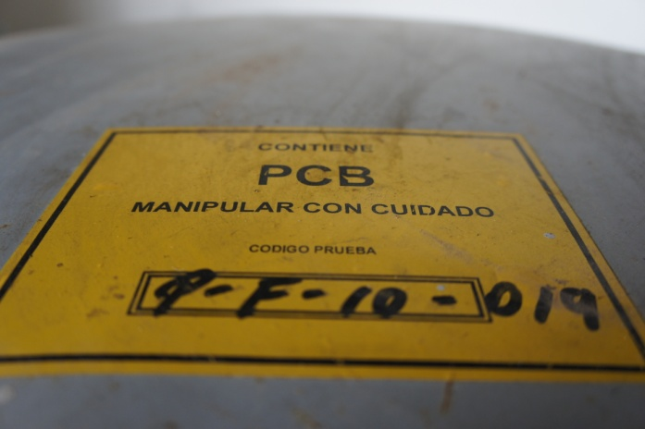
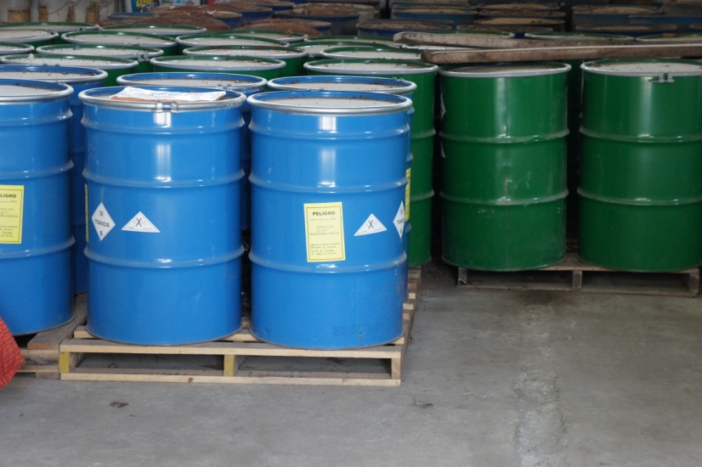
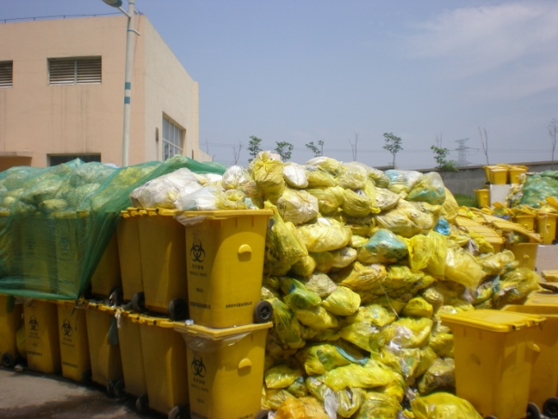
Contact Information
Ibrahima Sow Chemicals Cluster Coordinator isow@thegef.org
Anil Sookdeo Environmental Specialist asookdeo@thegef.org
Evelyn Swain Environmental Specialist eswain@thegef.org
Jie Pan Junior Professional Associate jpan@thegef.org
Marie Boucher On Detail from USEPA mboucher@thegef.org

