Slide 1
GEF 6 Programming Directions
Focal Areas, Integrated Thinking & Integrated Approach Pilots
Colombo, Sri Lanka
March 17-19, 2015

Slide 2
GEF-6 Programming
Integrated Approach
Pilots
Sustainable Cities
Food Security
Commodities
Chemicals & Waste
International Waters
Sustainable Forest Management
Climate Change
Mitigation
Climate Change
Adaptation
Focal Areas
Biodiversity
Land Degradation
Notes:
Now having presented the idea of Integrated Thinking, we want to highlight the Integrated Approach Pilots.
As you may have also heard of the Integrated Approach Pilots, which are new addition in GEF-6 and are intended to stimulate experimentation and risk=taking to address existing and emerging complex challenges facing the global environment. This effort is in line with the GEF-6 emphasis on multi-FA approaches – integrated portfolios. $45-$60M. Whereas the FAs $430M to $1.3B.

Slide 3
GEF- 6: Programming & Funding Sources
 | GEF Trust Fund: STAR Allocation | GEF Trust Fund: Non-STAR Allocation | LDCF / SCCF
Biodiversity (BD) | X
Land Degradation (LD) | X
Climate Change Mitigation (CCM) | X
International Waters (IW) |  | X
Chemicals and Waste (C&W) |  | X
Sustainable Forest Management (SFM) | X | X
Climate Change Adaptation (CCA) |  |  | X
Notes:
We’ll present the focal areas as they relate to the funding you learned about earlier.
The first 3 focal areas all have their funding tied to the STAR Allocations by country. First is Biodiversity -

Slide 4
GEF-6 Biodiversity Strategy
Goal: To maintain globally significant biodiversity and the ecosystem goods and services that it provides to society
BD1: Improve Sustainability of Protected Area Systems
BD 2: Reduce Threats to Globally Significant Biodiversity
BD 3: Sustainably Use Biodiversity
BD4: Mainstream Biodiversity Conservation and Sustainable Use into Production Landscapes/ Seascapes and Sectors
1. Improving financial sustainability and effective management of the national ecological infrastructure
3. Preventing the extinction of known threatened species
6. Ridge to Reef+: Maintaining integrity and function of globally significant coral reefs
9. Managing the human-biodiversity interface
4. Prevention, control, and management of invasive alien species.
7. Securing Agriculture’s Future: Sustainable use of plant and animal genetic resources.
10. Integration of biodiversity and ecosystem services into development and finance planning
2 . Nature’s Last Stand: Expanding the reach of the global protected area estate.
5. Implementing the Cartagena Protocol of Biosafety
8. Implementing the Nagoya Protocol on Access and Benefit Sharing.

Slide 5
GEF- 6: Programming & Funding Sources
 | GEF Trust Fund: STAR Allocation | GEF Trust Fund: Non-STAR Allocation | LDCF / SCCF
Biodiversity (BD) | X
Land Degradation (LD) | X
Climate Change Mitigation (CCM) | X
International Waters (IW) |  | X
Chemicals and Waste (C&W) |  | X
Sustainable Forest Management (SFM) | X | X
Climate Change Adaptation (CCA) |  |  | X
Notes:
Land Degradation is also tied to STAR allocations by country.

Slide 6
GEF-6 Land Degradation Strategy
Goal: To arrest or reverse land degradation (desertification and deforestation)
LD 1: Agriculture and Rangeland Systems
LD 2: Forest Landscapes
LD 3: Integrated Landscapes
LD 4: Institutional and Policy Frameworks
1. Agro-ecological Intensification – efficient use of natural capital (land, soil, water, and vegetation) in crop and livestock production systems
3. Landscape Management and Restoration – community and livelihood-based options for increasing forest and tree cover
4. Scaling-up SLM – moving appropriate interventions to scale for crop and rangeland productivity
5. Mainstreaming SLM in Development – influencing institutions, policies, and governance frameworks for SLM
2. SLM in Climate-Smart Agriculture – innovative practices for increasing vegetative cover and soil organic carbon

Slide 7
GEF- 6: Programming & Funding Sources
 | GEF Trust Fund: STAR Allocation | GEF Trust Fund: Non-STAR Allocation | LDCF / SCCF
Biodiversity (BD) | X
Land Degradation (LD) | X
Climate Change Mitigation (CCM) | X
International Waters (IW) |  | X
Chemicals and Waste (C&W) |  | X
Sustainable Forest Management (SFM) | X | X
Climate Change Adaptation (CCA) |  |  | X
Notes:
Climate Change Mitigation is also tied to STAR allocations by country.

Slide 8
GEF’s Unique Value for Climate Financing
1. Facilitating innovation & technology transfer
2. Catalyzing systemic impacts through synergistic multi-focal initiatives
3. Building on Convention obligations for reporting & assessments towards mainstreaming
Assisting developing countries in defining and implementing mitigation measures towards 2015 agreement
Notes:
We have a 20+ years of history of supporting mitigation, and then adaptation projects on the ground.
The GEF-6 period is particularly special for the climate change arena. First and foremost, the anticipated 2015 agreement falls right in the middle of the GEF-6 period. Also the Green Climate Fund has been established.
The GEF as an institution is also evolving, responding to the guidance from the COP, learning from the lessons of our history, feedback from our partners (countries and GEF Agencies), and seeing the trends in how countries address the climate challenges with GEF financing.
Following the GEF2020 vision, our strategy comprises a multi-pronged approach to help countries address key drivers of global environmental degradation that stem from underlying global mega-trends, notably urbanization, population growth, and the rising middle class, while also seeking to enhance synergies across focal areas.
With this background, in GEF-6, our strategy explores complementarity to maximize synergies.
There are three elements that define GEF’s unique value propositions in climate financing.
Facilitating innovation and technology transfer
GEF resources play a key role in piloting emerging innovative solutions including technologies, management practices, supportive policies and strategies, and financial tools
Catalyzing systemic impacts through synergistic multi-focal initiatives
There is a strong correlation between climate change and the other GEF focal areas, as well as an increasing synergy among their respective objectives
Examples of synergies are; Coupled mercury emission reduction and energy efficiency improvement in manufacturing sector
Building on Convention obligations for reporting and assessments towards mainstreaming
The GEF is currently the only institution with the mandate to finance NCs and BURs, and supports NAMAs, TNAs, NAPAs, and other assessments. The GEF will also provide support to countries to initiate or intensify domestic preparations for their INDCs for COP 21 in Paris.

Slide 9
GEF-6 Climate Change Mitigation Strategy
Goal: To support developing countries to make transformational shifts towards low emission, resilient development path
Objective 1: Promote innovation & technology transfer
Objective 2: Demonstrate systemic impacts of mitigation options
Objective 3: Foster enabling conditions to mainstream mitigation concerns into SD strategies
1. Low carbon technologies and mitigation options
3. Integrated low-carbon, urban systems
5. Convention obligations for planning and mitigation contributions
2 . Innovative policy packages and market initiatives
4. Forests and other land use, and climate smart agriculture
Notes:
The goal of the GEF-6 Climate Change Mitigation Program is to support developing countries and economies in transition to make transformational shifts towards a low emission development path. The GEF support also aims to enable recipient countries to prepare for the new instrument under the UNFCCC applicable to all Parties.
We have three objectives that support this goal:
Promote innovation, technology transfer, and supportive policies and strategies
Demonstrate mitigation options with systemic impacts
Foster enabling conditions to mainstream mitigation concerns into sustainable development strategies
There are five key programs that derive from these objectives. They represent a suite of measures to assess and address risks and barriers that remain in the transformation toward low-carbon development.
These programs aim to achieve three main outcomes: 1) accelerated adoption of innovative technologies and management practices, 2) established policy, planning and regulatory frameworks , and 3) demonstrated and operationalized financial mechanisms to support GHG reduction.

Slide 10
GEF- 6: Programming & Funding Sources
 | GEF Trust Fund: STAR Allocation | GEF Trust Fund: Non-STAR Allocation | LDCF / SCCF
Biodiversity (BD) | X
Land Degradation (LD) | X
Climate Change Mitigation (CCM) | X
International Waters (IW) |  | X
Chemicals and Waste (C&W) |  | X
Sustainable Forest Management (SFM) | X | X
Climate Change Adaptation (CCA) |  |  | X
Notes:
The next 2 Fas have funding that is not tied to STAR allocations. This means that there is a general set of funds for each of these two focal areas and distribution is based on meeting the priorities of the FA.

Slide 11
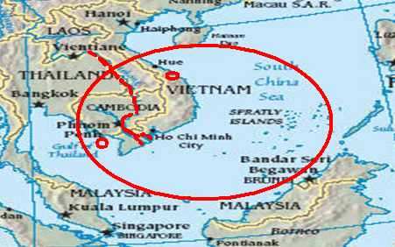
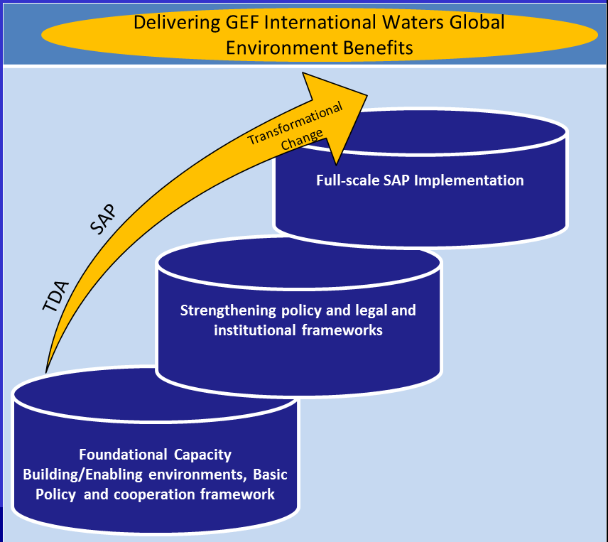
GEF IW Multiple Scales and Modalities

Slide 12
International Waters GEF- 6 Strategy
Goal: To promote collective management of transboundary water systems and implementation of the full range of policy, legal and institutional reforms and investments contributing to sustainable use and maintenance of ecosystem services
Objective 1: Catalyze Sustainable Management of Transboundary Waters
Objective 2: Balance Competing Water-uses in the Management of Transboundary Surface and Groundwater
Objective 3: Rebuild Marine Fisheries, Restore and Protect Coastal Habitats, and Reduce Pollution of Coasts and LMEs
1. Foster Cooperation for Sustainable use of Trans- boundary Water Systems & Economic Growth
3. Advance Conjunctive Management of Surface & Groundwater systems
5. Reduce Ocean Hypoxia
6. Prevent the Loss and Degradation of Coastal Habitat
2 .Increase Resilience & Flow of Ecosystems Services in Context of Melting High Altitude Glaciers
4. Water/Food/Energy/
Ecosystem Security Nexus
7. Foster Sustainable Fisheries
Notes:
GEF 6 IW Strategy

Slide 13
GEF- 6: Programming & Funding Sources
 | GEF Trust Fund: STAR Allocation | GEF Trust Fund: Non-STAR Allocation | LDCF / SCCF
Biodiversity (BD) | X
Land Degradation (LD) | X
Climate Change Mitigation (CCM) | X
International Waters (IW) |  | X
Chemicals & Waste (C&W) |  | X
Sustainable Forest Management (SFM) | X | X
Climate Change Adaptation (CCA) |  |  | X
Notes:
Similar to International Waters, Chemicals and Waste also has funding separate from the STAR allocation.

Slide 14
GEF-6 Chemicals & Waste Strategy
Goal: to prevent the exposure of human and the environment to harmful C&W of global importance, including POPs, mercury and ODS, through a significant reduction in the production, use, consumption and emissions/releases of those chemicals and waste
Objective 1: Develop the enabling conditions, tools and environment for the sound management of harmful chemicals and wastes
Objective 2: Reduce the prevalence of harmful chemicals and waste and support the implementation of clean alternative technologies/substances
1. Develop and demonstrate new tools and economic approaches for managing harmful chemicals and waste in a sound manner
3. Reduction and elimination of POPs
4. Reduction or elimination of anthropogenic emissions and releases of mercury to the environment
2. Support enabling activities and promote their integration into national budgets and planning processes, national and sector policies and actions and global monitoring
5. Complete the phase out of ODS in CEITs and assist Article 5 countries under the Montreal Protocol to achieve climate mitigation benefits
6. Support regional approaches to eliminate and reduce harmful chemicals and waste in LDCs and SIDs
Notes:
In the past decades, governments have established a global regime to address harmful chemicals and waste through the negotiation of a number of Multilateral Environmental Agreements (MEAs) and non-binding instruments.
The GEF-6 coincides with a period of a rapidly evolving global agenda and changing needs.
Accordingly, the strategy has evolved as well from “POPs” to “Chemicals and Waste”, which targets chemicals controlled under Stockholm and Minamata Convention and SAICM, and waste generated from the production and use of those chemicals are targeted, and become the name of the strategy.
The GEF-6 strategy’s long term goal is to prevent the exposure of humans and the environment to harmful chemicals and waste of global importance, including POPs, mercury and ozone depleting substances, through a significant reduction in the production, use, consumption and emissions/releases of those chemicals and waste.
The GEF-6 strategy has TWO objectives;
Objective 1; Develop the enabling conditions, tools and environment for the sound management of harmful chemicals and wastes
Objective 2: - Reduce the prevalence of harmful chemicals and waste and support the implementation of clean alternative technologies/substances
Program 1 and 6 apply to all chemicals and waste, and Program 2 to 5 apply to POPs, Mercury, and ODS in CEITs.
Also the GEF supports important enabling activities including update of NIP, MIA and ASGM NAP.

Slide 15
Support to integrated approaches
Chemical and Waste components relevant integrated approaches to address key issues,
including:
For Cities
Promote comprehensive waste management systems in municipalities through promotion of the 3R, and eradication of open burning of municipal, medical and electronic waste which contain hazardous chemicals- POPs and mercury
Phase out PCBs in electrical equipment and the electrical grid
Phase out the use of mercury in products, lighting, etc…
Promote BAT/BEP to reduce UPOPs emission from industrial processes
For Food security
Promote Sound management of pesticides used in urban agriculture
Assessment and clean up of agricultural lands contaminated with hazardous POPs and/or other hazardous chemicals

Slide 16
GEF- 6: Programming & Funding Sources
 | GEF Trust Fund: STAR Allocation | GEF Trust Fund: Non-STAR Allocation | LDCF / SCCF
Biodiversity (BD) | X
Land Degradation (LD) | X
Climate Change Mitigation (CCM) | X
International Waters (IW) |  | X
Chemicals & Wastes (C&W) |  | X
Sustainable Forest Management (SFM) | X | X
Climate Change Adaptation (CCA) |  |  | X
Notes:
Sustainable Forest Management draws on both STAR Allocation Funds and Non-STAR funds. In order to access SFM funds, a project has to allocate funding from its STAR allocation. The funds need to come from at least 2 Fas (so BD, LD and/or CCM) and for every $2M of STAR funds, SFM provides $1. And also there has to be a $2M minimum from STAR.

Slide 17
GEF-6 Sustainable Forest Management Strategy
Goal: To achieve multiple environmental, social and economic benefits from improved management of all types of forests and trees outside of forests.
SFM 1: To maintain forest resources
SFM 2: To enhance forest management
SFM 3: To restore forest ecosystems
SFM 4: To increase regional and global cooperation
Integrated land use planning
Identification and monitoring of HCVF
Identifying and monitoring forest loss
Developing and implementing model projects for PES
Capacity development for SFM within local communities
Supporting sustainable finance mechanisms for SFM
Building of technical and institutional capacities to identify degraded forest landscapes and monitor forest restoration
Integrating plantation management in landscape restoration
Private sector engagement
Global technologies for national progress

Slide 18
GEF- 6: Programming & Funding Sources
 | GEF Trust Fund: STAR Allocation | GEF Trust Fund: Non-STAR Allocation | LDCF / SCCF
Biodiversity (BD) | X
Land Degradation (LD) | X
Climate Change Mitigation (CCM) | X
International Waters (IW) |  | X
Chemicals and Wastes (C&W) |  | X
Sustainable Forest Management (SFM) | X | X
Climate Change Adaptation (CCA) |  |  | X
LDCF – Least Develop Countries Fund
Eligible countries from XXX region:
SCCF – Special Climate Change Fund
Eligible countries: All
Notes:
Finally, the last FA is CCA. Unique to the other Fas, CCA is funded through a different trust fund – LDCF and SCCF. In this region ADD

Slide 19
Adaptation Programming Strategy: Goal & Objectives
Goal: “increase resilience to the adverse impacts of climate change in vulnerable developing countries, through both near- and long-term adaptation measures in affected sectors, areas and communities…”
1) Reduce the vulnerability of people, livelihoods, physical assets and natural systems
2) Strengthen institutional and technical capacities
3) Integrate climate change adaptation into relevant policies, plans and associated processes
Notes:
The goal of the GEF adaptation program is to increase resilience ot the adverse impacts of climate change in vulnerable developing countries, through both near- and long-term adaptation measures in affected sectors, areas and communities; leading to a reduction of expected socio-economic losses associated with climate change and variability
The goal is supported through three strategic objectives:
Reduce the vulnerability of people, livelihoods, physical assets and natural systems to the adverse effects of climate change;
Strengthen institutional and technical capacities for effective climate change adaptation
Integrate climate change adaptation into relevant policies, plans and associated processes

Slide 20
Adaptation Programming Strategy: Thematic Priorities
Agriculture and food security
Water resources management
Coastal zone management
Infrastructure
Disaster risk management
Natural resources management
Health
Climate information services
Climate-resilient urban systems
Small Island Developing States
Notes:
Based on the two pillars and the interest in private sector engagement and EBM, the APS will focus on ten priority areas. The first seven correspond to the core sectors.
Climate service info services is a cross-cutting priority
And the remaining two are priorities across GEF focal areas
Approx 29% of LDCF and 26% of SCCF investments promote adaptation in Agr & Food security , including demo and deployment of innovative, climate resilient techn for agr production and processing.
Water resource management is another important theme that has captured 14% of LDCF project funds and nearly 25% of SCCF providing support to issues of climate-resilient water governance, watershed management , and the transfer and adoption of technologies for water harvesting and efficiency.
Reduce vulnerability of coastal communities to CC impacts through improved land-use planning, climate-resilient coastal infrastuture and the sustainable mgt of strengthening early-warning systems,
Infrasture refers to designing resilient transportation, urban settlements, water supplies, sanitation and energy facilities
Reduce risk from disaster risks across sectors through info services, capacity building and public works.
NRM strengthening environmental management in vulernable areas, such as protecting wetlands that provide shoreline proection.
Health – refers to mainstreaming CCA into the public health sector. To date only 3% of SCCF.
----
Approx 29% of LDCF and 26% of SCCF investments promote adaptation in Agr & Food security , including demo and deployment of innovative, climate resilient techn for agr production and processing.
Projects under this theme include 1) integrating climate-resilient tools and measures into agr policies; policy and regu env as well as reforming incentive structures and subsdidies and expanding access to markets, credit risk and transfer and other financies services along with acess to extension services, agro-meterological info and climate-resilient techn. There are numerous opportunities for linking with all the other GEF focal areas. And tremendous potential for expanding private sector engagement by working throughout the agr supply change and by enhancing access to insurance and micro-finance services.
Water resource magenemtn is another important theme that has captured 14% of LDCF project funds and nearly 25% of SCCF providing support to climate-resilient water governance, watershed mgt, and the transfer and adoption of technologies for water harvesting and efficienty. There are a number of new areas for future consideration, including: 1) adoption of proven technolgoies; 2) enhancing the knowledge based for c-resilient mgt, and strengthening regulatory frameworks and economic incentrive structures.
CZ are at the interface of both land and sea impacts from CC and are therefore highly vulnerable. 13 and 11% of LDCF and SCCF – reduce vulnerability of coastal communities to CC impacts (e.g. sea level rise, storms, floods, erosion) through improved land-use planning, climate-resilient coastal infrastuture and the sustainable mgt of natural infrasturutures. We are looking to strengthening early-warning systems, promoteing diversified and resilient livelihoods, integrating adaption measures into coastal settlmetn planning and infrasturre investments and sacling up private-sector engagement (e.g. climate-proofing ports, coastal roads, tourism.
Infrasture is reflected in the previous sectors and includes not only address CZ Mgt and enhanced flood risk mgt, but also areas of transportation, urban settlements, water supplies and sanitation and energy. GEF funds are seeking to strengthen structural codes and standards and their enforcement, mainstream adaptation tools across infrastructure planning and development and catalyze private sector investments in infrastructure and settlement planning.
DRM – the Adaptation Program has financed measures to reduce CC-induced disaster risks across sectors through info services, capacity building and public works. In particular need to further mainstream DR info, assessment tools and appropriate mitigation measures acros relevant policies, dev frameworks and investment plans, strengthen disaster preparedness for effective response at all levels and disaster contingency planning, increase access to early-warning info, edu and awareness raising on CC-induced hazards at all levels and promote the dev of an access to financial insturments for DRM, including risk transfer.
NRM has served as a means to enhance not only natural assets, but also people and their livelihoods and to reduce the vulnerability of fragile ecoystems. This includes, inter alia, strengthening environmental mgt in vulernable areas; pteocting ecosystem and natural resources that shield communities from cosatal hazards and flood risk (ie reefs and mangroves) and promoting sustainable, resilient and diversified livelihoods.
Health – to date only 3% of SCCF. There is a considerable need to strengthen evidenceto mainstream CCA in the public health sector. The World Health Organization has been a particularly cirtical partner in these efforts in supporting the NAP process in LDCs.

Slide 21
GEF- 6: Programming & Funding Sources
 | GEF Trust Fund: STAR Allocation | GEF Trust Fund: Non-STAR Allocation | LDCF / SCCF
Biodiversity (BD) | X
Land Degradation (LD) | X
Climate Change Mitigation (CCM) | X
International Waters (IW) |  | X
Chemicals & Waste (C&W) |  | X
Sustainable Forest Management (SFM) | X | X
Climate Change Adaptation (CCA) |  |  | X
Notes:
In summary there are 7 Fas.
Now having shared with you each FA, we want to stress a new emphasis in GEF-6, which is INTEGRATED THINKING by which we mean…

Slide 22
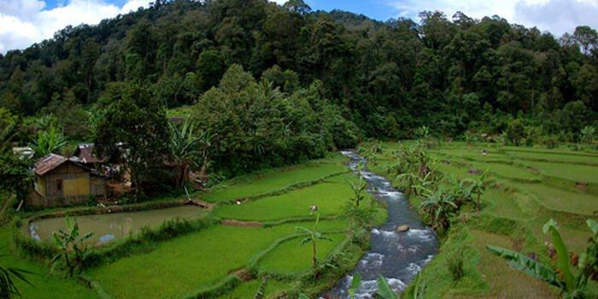
Water, Food, Energy Nexus
GEF-6 Integrated Thinking
PROPOSED PROJECT:
LD Program 1: Agro-ecological Intensification
IW Program 3. Advance Conjunctive Management of Surface & Groundwater Systems
Address unsustainable agriculture (Land Degradation)
that is causing eutrophication of the river (International Waters)
and encroaching on the neighboring protect area (Biodiversity)
BD Program 3. Preventing the extinction of known threatened species
through deforestation (Climate Change Mitigation)
CCM Program 4: Forests and Other Land Use and Climate Smart Agriculture

Slide 23
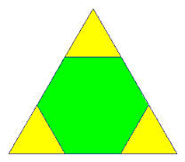
Integrated Thinking
Using integrated thinking, propose creative and inclusive solutions
Solutions should deliver results that align with GEF-6 focal area objectives
Single FA projects might still be necessary in specific contexts
MFA projects on the rise
FA
MFA
FA
FA

Slide 24
Thank you!

