Slide 1
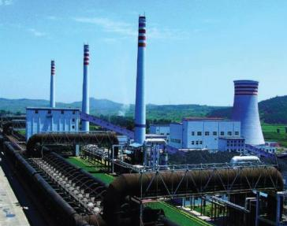
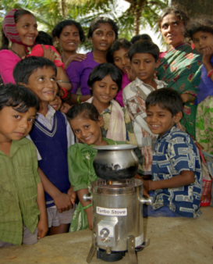
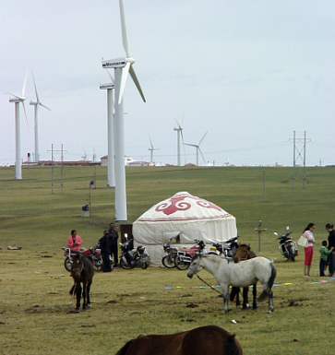
Expanding Engagement with the Private Sector on GEF Projects
Lake Victoria, Uganda
July 21-22, 2015

Slide 2
Expanding Private Sector Engagement in GEF Projects (1)
Private sector engagement is not new; but GEF projects can deliver more by partnering on sustainable business models and attracting more investment for environmental benefits
During GEF-5 → the Council approved five innovative PPPs (three in LAC) with a
total funding commitment of $70 million which has attracted $907 million in co-financing → potential to generate re-flows
The IDB Sustainable Caribbean Basin Private Equity Fund ($15 Million - co-financing $200 million) seeks to foster private investments that promote energy security, environmental sustainability and related economic opportunities in nations across the Caribbean Basin.
    highly innovative investment platforms and business models that expand access to clean and safe energy, achieve the sustainable use of natural capital, and generate opportunities for local businesses and low income populations, including women and indigenous people

Slide 3
Expanding Private Sector Engagement in GEF Projects (2)
The IDB MIF PPP Program ($15 Million – co-financing $266 Million) is making targeted equity investments in funds to promote energy efficiency, renewable energy, and bio-diversity in Latin America.
  investments will contribute to energy savings, new renewable energy supply, reduction of greenhouse gas (GHG) emissions, preservation of natural resources, protection of bio-diversity, and development of sustainable business models.
The IDB Climate-Smart Agriculture Fund For The Americas ($5 Million – co-financing $50.9 Million) is catalyzing greater private sector investments in sustainable agriculture, forestry and rangeland systems in order to maintain and improve the flow of agro-ecosystem services from productive landscapes in the face of climate change and increasing resource scarcity.
    focuses on the synergies between private sector funds and agricultural development funds. It will also be the first fund tailored to incentivize private sector investment in climate-smart agriculture.

Slide 4
Expanding Private Sector Engagement
In GEF-6 we are pursuing:
Mainstreaming - seeking private sector engagement in all projects
2. Integrated Approach Pilots - targeted pilots
3. Non-grant instrument Pilot - special set-aside

Slide 5
(1) Non-grant Instrument Pilot (NGI)
115 Million → $5 million will be reserved for the Sustainable Cities Integrated Approach Pilot
Objective → to support the achievement of the GEF’s objectives through the use of non-grant instruments for targeted investments that promote global environmental benefits
Until now, non-grant instruments have not been used in the GEF’s engagement with public sector entities → we expect this to happen
The use of non-grant instruments under the GEF-6 Pilot will be focused on instruments that have the potential to generate reflows → contribute to the GEF Trust Fund’s financial sustainability

Slide 6
(2) Non-grant Instrument Pilot (NGI)
By demonstrating and validating successful models for the use of non-grant instruments, the GEF can help catalyze large-scale changes through broader adoption and generate experiences which may also be useful for other international environmental funding mechanisms
Selection criteria:
  Demonstrate use of non-grant instruments in areas other than climate change
  Demonstrate innovative application of financial mechanisms and partnerships that may be broadly adopted and can be scaled up;
  Support innovative engagement of the private sector and public sector through innovative business models;
  Deliver high levels of co-financing

Slide 7
(3) Non-grant Instrument Pilot (NGI)
For projects/programs with private sector recipients, the GEF Partner Agency will negotiate an appropriate concessional rate or return on investment, which, consistent with the Agency’s regular practices → no necesita carta de endoso de PFO
For projects/programs with loans to public sector recipients, the Pilot will use differentiated terms:
  LDCS and SIDS: 40 years maturity, 10 years grace period, 0,25% interest
  Non LDCS - SIDS: 20 years maturity, 10 years grace period, 0,75% interest
In case of the use of guarantee instruments for public sector entities, the reflow schedule and fees will be negotiated on a case-by-case basis by the GEF Partner Agency

Slide 8
Typical types of private sector actors for GEF projects
Type
Description/Examples
1
Capital providers
  Pension funds, VCs
2
Financial intermedi-aries and facilitators
  Investment banks, commercial banks, financial advisory services
3a
Industry players – large corporations
  Large retail, manufacturing companies, project developers, etc.
3b
Industry players – SMEs
  Full time staff below 250 or less depending on the country
3c
Industry players – individuals/ entrepreneurs
  Small start-ups with full time staff below 10

Slide 9
Benefits of Private Sector Engagement
The private sector can strengthen partnerships and make contributions to environmental and developmental solutions, such as:
1. Additional funding
2. Expertise/skills/knowledge
3. Innovation
4. Technology transfer
5. Phase out substandard products

Slide 10
Reflections on selected GEF projects in this region
We reviewed a few GEF projects to learn:
>
Was the private sector part of the problem and solution?
>
Is there an essential contribution of private sector stakeholders in the project?
>
What results or lessons learned can provide insights for future private sector engagement?
We used the GEF intervention models to review these projects

Slide 11





The GEF regularly uses five intervention models
1
Transforming policy and regulatory environments
2
Strengthening institutional capacity and decision-making
3
Deploying innovative financial instruments
4
Convening multi-stakeholder alliances
5
Demonstrating innovative Approaches

Slide 12
Transformation of policy and regulatory environments
Capacity Strengthening and Technical Assistance for the Implementation of the Stockholm Convention (GEF ID 3948/3968-3969) UNIDO/UNEP
Focal Area
Objective of the Project
GEF
POPs
Assistance with developing comprehensive legislative and regulatory frameworks for chemicals management required toward the elimination and reduction of POPs.
Strengthen and build the capacity to implement the Stockholm Convention and the sound management of chemicals in ECOWAS and COMMECO LDCs and SIDS.
Private Sector
Best practices and lessons learned
Private sector consultation on the regulatory framework for chemical management development process.
Private sector participates with its technical capacity and capital investment in public private partnerships pilot projects.
Complementary “division of labor” between the two implementing agencies, with UNEP providing guidance on policy, legislative and regulatory framework.

Slide 13
Strengthening institutional capacity and decision-making processes
Capacity Strengthening and Technical Assistance for the Implementation of the Stockholm Convention (GEF ID 3948/3968-3969) UNIDO/UNEP
Focal Area
GEF
POPs
Objective of the Project
Assistance with strengthening the technical and financial capacity for chemicals management, including training to the government and public private partnerships, required toward the elimination and reduction of POPs.
Strengthen and build the capacity to implement the Stockholm Convention and for the sound management of chemicals in ECOWAS and COMMECO LDCs and SIDS.
Best practices and lessons learned
Private Sector
Complementary “division of labor” between two implementing agencies, with UNIDO identifying and designing pilot projects that include private sector participation.
Participates with its technical capacity and capital investment in public private partnerships to create micro- or small enterprises based on innovative technologies to: (i) produce bio- botanical pesticides; (ii) recycle plastic bags; and (iii) recycle used paper and e-waste.

Slide 14
Deploying innovative financial instruments
Geothermal Power Generation Program (GEF ID 4626) World Bank
Focal Area
GEF
Climate Change
Objective of the Project
A blend of GEF’s grant and non-grant instrument used to foster private sector participation in the energy sector through risk reduction (by subsidizing the drilling of four geothermal production wells).
Reduce GHG emissions in Djibouti and increase electricity access of Djibouti’s population through renewable (geothermal) energy.
Private Sector
Best Practices and Lessons Learned
The project is a risky investment for private sector only mitigated through the use of GEF funds.
Competitive call for tender to engage the Drilling Services Company (DSC) that will execute the drilling program.
A non-grant instrument is designed into the project, allowing the National Government to recycle unused funds into future geothermal drilling activities, which will leverage private funds.

Slide 15
Establishment of multi-stakeholder partnerships
Payment for Ecosystem Services (PES) to Support Forest Conservation and Sustainable Livelihoods in Mozambique (GEF ID 5516) FAO
Focal Area
GEF
Multi Focal Area
Support capacity building to implement and monitor a PES mechanism for the disbursement of 20% of all government taxes and fees collected from the use of wildlife and protected areas to local communities.
Objective of the Project
Promote biodiversity conservation and climate change mitigation while creating financial resources.
Private Sector
Forest concessions, including charcoal producers for the domestic and international market, will pay taxes, of which 20% will feed into a fund managed by the PES scheme / A joint venture of public and private companies.
Best practices and lessons learned
An alliance of the project’s stakeholder helped align incentives for the successful implantation of the project / joint venture helped sponsor a scoping study (involving research institutions) to trigger private sector interest in investing in eco-system services.

Slide 16
Piloting Innovative Approaches
Geothermal Power Generation Program (GEF ID 4626) World Bank
Focal Area
GEF
Climate Change
Objective of the Project
In conjunction with the reduction of risk, the project provides the direct financial benefit of reducing the geothermal power plant cost, should the GEF-funded geothermal fuel exploration be successful.
Reduce GHG emissions in Djibouti and increase electricity access of Djibouti’s population through renewable (geothermal) energy.
Private Sector
A follow on project meant at developing a geothermal power plant will be financed by the private sector, provided that the resource is confirmed for commercial power generation
Best practices and lessons learned
The GEF investment helped reduce the geothermal power “entry cost” that has effectively halted Djibouti’s development of the resource and private equity investments.

Slide 17
Private sector engagement exercise
>
Would private sector engagement contribute to environmental benefits and my projects?
>
Identify specific actions to engage the private sector and include private sector in project design and implementation.
>
Think about who you would need to involve, through the project design, which agency, why.
>
Examples include 1) forestry: private sector alliances to help design lacking regulatory policies and 2) e-waste: corporate partners.

Slide 18
Documents and Publications

Slide 19
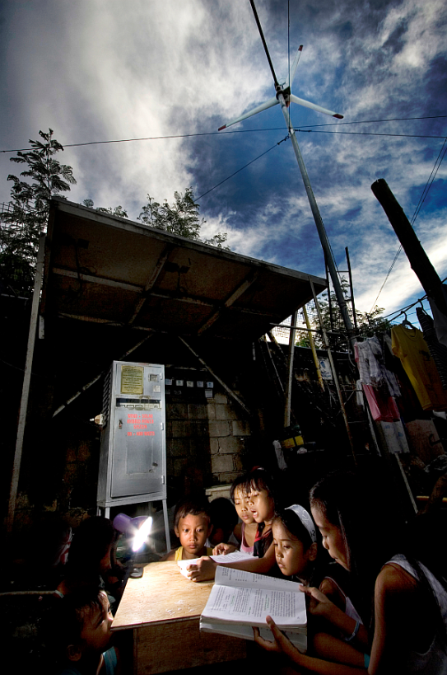
Your Questions or Ideas!
Contact your country support representative.
More information is also available at the following link: www.thegef.org/gef/privatesector

