Slide 1
Results Based Management in the GEF
Notes:
Welcome everyone.
I am XXX and I will give you a just under three minutes overview on Results Based Management in the GEF – and before the first person takes a nap – we will move on to continue the previous exercise, but this time with a focus on RBM.

Slide 2
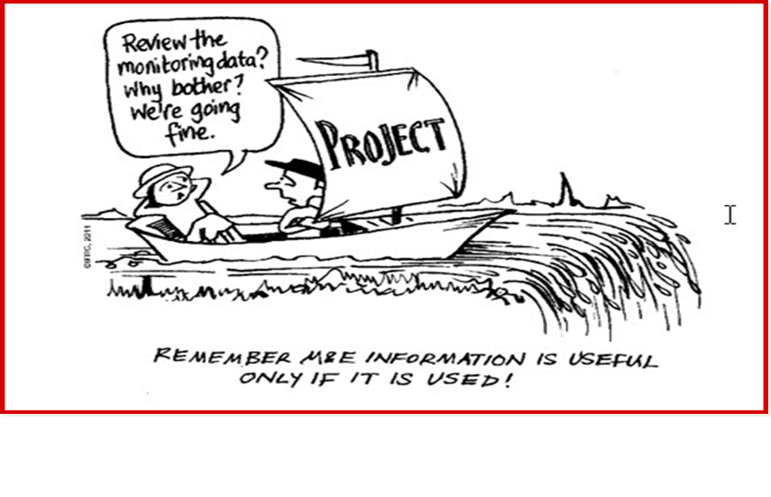
Notes:
To some people monitoring, reporting, evaluation, results based management sounds like music in their ears. For others it’s exactly the opposite. Let me guess to which camp most of you belong ? Hmmmm ….
Anyway, let’s have a look at this slide: The fellow sailor says: Review the monitoring data? Why bother, we are going fine. – Are they indeed going fine? Well, I don’t really think so. And yes – this slide tells us that information from monitoring is useful ONLY IF IT IS USED !!!

Slide 3
A robust system to ensure that key management decisions are based on results is critical to help the GEF network achieve its objectives
Results
Based
Management
Project Level Results
GEF Desired Results
Achieving Global Environmental Benefits
Portfolio Level Results
Notes:
So what is Results Based Management? It is a robust system to ensure that key management decisions are based on results is critical to help the GEF network achieve its objectives.
The definition above, from CIDA, is less RBM jargon heavy. However, formally, the GEF uses OECD/DAC terminology for all RBM related terms. RBM defined by OECD/DAC:
“a management strategy focusing on performance and achievement of outputs, outcomes, and impacts.”
The GEF 2020 Strategy describes an increased focus on drivers of change and securing multiple environmental benefits through integrated approaches. RBM is highlighted as vitally important to ensure outcomes and impacts. In addition, the GEF-6 Programming Directions also present the GEF’s corporate results framework. The GEF desired results of Global Environmental Benefits are at the heart of the GEF’s corporate results framework.
Let’s have another look at the slide: I would just like you to distinguish between project level results and portfolio level results. Monitoring and reporting at project level is critically important to ensure that a project is on track towards achieving its objectives. Therefore RBM is an important tool used by the project manager.
Portfolio level results come from the aggregation of project level results. This is done at the GEF Secretariat. Data from this exercise are presented to the Council and help the Council make informed decisions, for example the amount of funding for particular interventions or action areas in the next replenishment.
Most of you may be somewhat familiar with the GEF tracking tools, which for each focal area contain a number of important indicators. These tracking tools must be filled three times during the implementation of a GEF project: at inception, mid-term and completion. As just explained before, the data from these tracking tools get aggregated up to portfolio level results.
In order to make this session a lot less theoretical, let me introduce our exercise. The exercise is meant to help you understand how global environmental benefits can be measured. And we want you to find out, which indicators are suitable for the projects you have discussed just before.
Background information (no need to read it out, just in case someone asks for more details)
GLOBAL ENVIRONMENTAL BENEFITS (https://www.thegef.org/gef/GEB)
GEF investments are predicated on the delivery of global environmental benefits in biodiversity, climate change mitigation, international waters, land degradation and forests, and chemicals and waste. Increasingly, GEF is seeking to deliver multiple environmental benefits through integrated investments across the various dimensions of the global environment.
Biodiversity
Global environmental benefits resulting from GEF’s biodiversity financing include:
Conservation of globally significant biodiversity;
Sustainable use of the components of globally significant biodiversity; and
Fair and equitable sharing of the benefits arising from the utilization of genetic resources, including by appropriate access to genetic resources.
Climate Change Mitigation
Global environmental benefit in the Climate Change Mitigation focal area is the sustainable mitigation of the concentration of anthropogenic greenhouse gases (GHG) in the atmosphere. Specifically, it includes:
Mitigated GHG emissions;
Increased use of renewable energy and decreased use of fossil energy resources;
Improved energy efficiency;
Increased adoption of innovative technologies and management practices for GHG emission reduction and carbon sequestration; and
Conservation and enhanced carbon stocks in agriculture, forest, and other land use.
Land Degradation
Global environmental benefits resulting from GEF’s focus on land degradation focal area, specifically addressing desertification and deforestation, include:
Improved provision of agro-ecosystem and forest ecosystem goods and services;
Mitigated/avoided greenhouse gas emissions and increased carbon sequestration in production landscapes;
Conservation and sustainable use of biodiversity in productive landscapes; and
Reduced pollution and siltation of international waters.
International Waters
Global environmental benefits targeted by GEF’s work in international waters relate to transboundary concerns, including:
Multi-state cooperation to reduce threats to international waters;
Reduced pollution load in international waters from nutrient enrichment and other land-based activities;
Restored and sustained freshwater, coastal, and marine ecosystems goods and services, including globally significant biodiversity, as well as maintained capacity of natural systems to sequester carbon; and
Reduced vulnerability to climate variability and climate-related risks, and increased ecosystem resilience.
Chemicals and Waste
GEF’s long term goal in chemicals and waste is to prevent the exposure of humans and the environment to harmful chemicals and waste of global importance, including persistent organic pollutants, mercury and ozone depleting substances, through a significant reduction in the production, use, consumption and emissions/releases of those chemicals and waste. Global environmental benefits resulting from GEF’s objectives in the area of chemicals and waste include:
Protected human health and environment through the reduction and elimination of mercury use and prevention of anthropogenic emissions and releases of mercury and mercury compounds;
Protected human health and environment through the phase out of production and consumption of ozone depleting substances;
Reduced risks on human health and the environment through reducing and eliminating production, use and releases of Persistent Organic Pollutants and their waste; and
Reduced risks on human health and the environment through sound management of chemicals and waste of global concern.
Sustainable Forest Management/REDD+
Multiple global environmental benefits addressing the emphasis placed by UNFCCC, CBD and UNCCD on the importance of conservation, sustainable use and management of forests, include:
Reduction in forest loss and forest degradation;
Maintenance of the range of environmental services and products derived from forests; and
Enhanced sustainable livelihoods for local communities and forest-dependent peoples.

Slide 4
GEF RBM Framework
Global Environmental Benefits
(Impacts)
Outcomes
Outputs
Institutional Level
Corporate
Goals
Focal Area Goal
Focal Area Objectives
Operating Level
Project Objectives
Notes:
And finally, let me just give you a visual overview of the GEF RBM Framework. It shows how the individual project outputs and outcomes lead to Global Environmental Benefits (GEBs), which are aggregated at corporate level.
Background text – no need to read it all out.
Each level of the pyramid is connected to the other in both an upward and downward direction. In this model the starting point for a monitoring system is a project’s logical/results framework (logframe). The logframe approach (LFA) is not new but it is still useful because it is built on the planning concept of a hierarchy of levels that link project inputs, activities, outputs, outcomes, and goals. A cause-and-effect relationship is assumed, with elements at the lower level contributing to the attainment of those above.
At the highest level of RBM is the institution as a whole. The lower levels contribute towards achieving the overall goal of the GEF. In the GEF Instrument, the GEF operates “as a mechanism for international cooperation for the purpose of providing new and additional grant and concessional funding to meet the agreed incremental cost of measures to achieve agreed global environmental benefits,” in six focal areas. The longer-term expected impact of achieving “global environmental benefits” at an institutional level cannot be monitored on a consistent, periodic basis. If, however, the GEF monitors how outputs and outcomes at the project and program level are progressing towards achieving global environmental benefits, a more in-depth study, analyzing causes and effects of GEF interventions can more accurately be carried out by an evaluation. In other words, the RBM system is part of a process intended to equip the GEF with the information needed to assess how the GEF interventions contribute toward its overall goal.
Three results levels: project, focal area or portfolio-level, and corporate-level. The GEF Secretariat is responsible for measuring results at the focal area or portfolio-level and at the corporate-level. GEF Agencies will ensure the measurement of results at the project-level

Slide 5
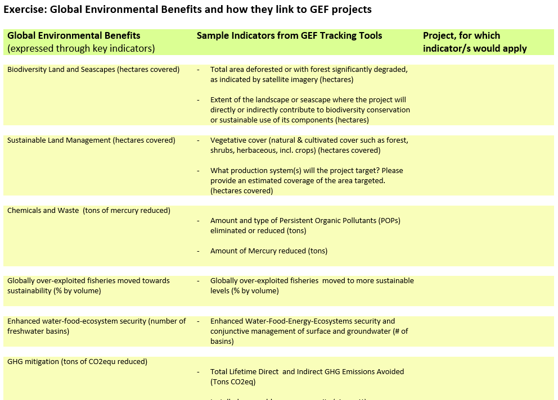
Exercise:
Global Environmental Benefits and how they link to GEF projects
Biodiversity Land and Seascapes (hectares covered) Sustainable Land Management (hectares covered) Chemicals and Waste (tons of mercury reduced) Globally over-exploited fisheries moved towards sustainability (% by volume) Enhanced water-food-ecosystem security (number of freshwater basins) GHG mitigation (tons of CO2equ reduced)
Notes:
So let’s have a look at the exercise. We will give you 10 – 15 minutes for it and then talk about it in plenary. The idea here is that you recall the projects we used for the earlier exercise and look at them with the GEF Global Environmental Benefits in mind. Since everything is about measurement, they are all expressed in the form of indicators. We have pulled just a few sample indicators from the GEF tracking tools and would like to invite you, to identify, which of the indicators could be used to measure progress in your projects. If you do not find a suitable indicator on this list, please list other indicators that could meaningfully help you measure progress of implementation of your project on the backside of the sheet. Colleagues and I will walk round to see whether you have any additional questions during the exercise.

Slide 6
Brief Discussion
Any feedback on this exercise? Did you find it useful?
Which group would like to talk about one of the projects and the indicators that related to it?
Is there a group who listed additional indicators?
Is there a group that discussed about multiple benefits, e.g. where a biodiversity project also has climate adaptation benefits?
Could you see a link to the SDGs?
Notes:
Additional questions to drill deeper and potentially guide the discussion in a better way:
In your job as focal points, why is it useful to use this type of indicators?
Please let us know which one or two indicators you found most suitable for a particular project and why?
Please share with us some additional benefits you would have liked to measure.
Some issues that may come up in the discussion:
Emphasize the importance of key indicators that are measured by all. Only that way aggregation is possible. “Don’t mix apple with pears.”
Indicators: They measure at different levels, e.g. output, outcome and impact. The indicators of the tracking tools (excel sheets to be filled with indicator values) measure outcomes. Often the impact of an intervention only becomes visible after project completion. Tracking tools are submitted at project inception together with the Project Identification From, at mid-term together with the Mid-Term Review and at project completion, together with the Terminal evaluation. Whilst tracking tools contain raw indicator data with limited qualitative information, Mid-Term Reviews on Terminal Evaluations contain much more comprehensive analysis of the projects progress, outcomes and impacts.
Multiple benefits: Our tracking tools currently operate pretty much in silos and we are not usually able to easily track multiple benefits. We are currently thinking about how we could have an improved system in the GEF 7 and would welcome comments from the audience on this.

Slide 7
Thank you!

