Slide 1
GEF Expanded Constituency Workshop STAP/GEF
New Delhi, India
November 2012

Slide 2
What is STAP?
In 1994, the GEF Instrument sets up STAP –
“UNEP shall establish, in consultation with UNDP and the
World Bank and on the basis of guidelines and criteria
established by the Council, the Scientific and Technical
Advisory Panel (STAP) as an advisory body to the Facility.
UNEP shall provide the STAP’s Secretariat and shall operate
as the liaison between the Facility and the STAP.” (Instrument
for the Establishment of the Restructured Global
Environment Facility, 1994 and 2008)
Notes:
In 1994, the GEF Instrument sets up STAP.
UNEP was chosen to host STAP because it is the U.N. body responsible for global environmental science/and global scientific assessments.

Slide 3
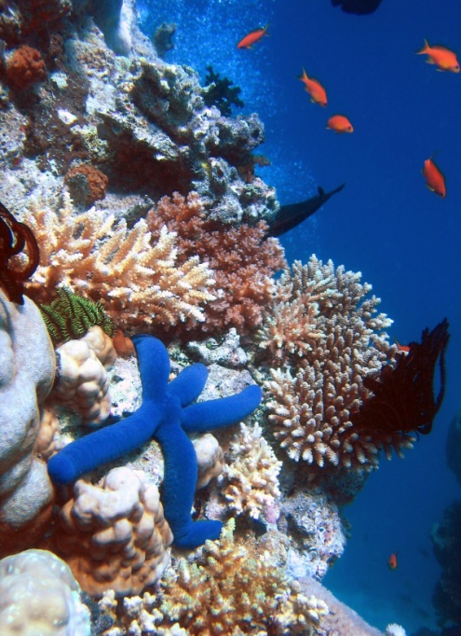
What is STAP?
The Scientific and Technical Advisory Panel (STAP)
of the Global Environment Facility (GEF) provides
strategic and independent advice on projects,
programs, and policies.
STAP is administered by the United Nations
Environment Programme (UNEP), and is
supported by a Secretariat in Washington, D.C
STAP serves as an interface between the wider scientific community and the GEF system; Panel members are scientists with strong connections with scientific networks, and an understanding of implementation issues & challenges
Notes:
STAP, therefore, provides strategic and independent advice on projects, programs, and policies. It is administered by UNEP...” Many of the Panel members are involved with scientific assessments such as the IPCC and the MEA, and with the GEC research programs.
Photo credit - Blue Linckia Starfish Ribbon Reefs, Great Barrier Reef - Richard Ling

Slide 4
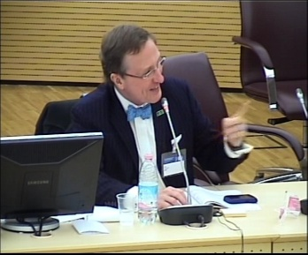
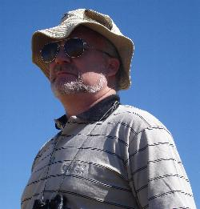
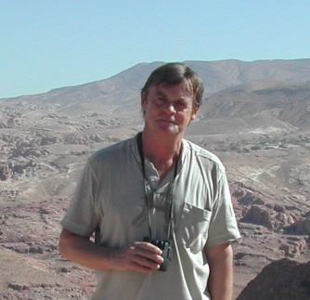
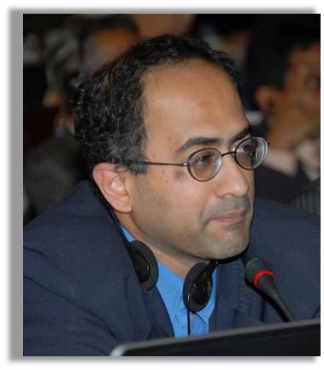
Who is STAP? – the Panel
Thomas E. Lovejoy, Chair
Jakob Granit
International Waters
N.H. Ravindranath
Acting Climate Change
Anette Cowie
Land Degradation
Sandra Diaz
Biodiversity
Henk Bouwman
Chemicals & POPs
Michael Stocking Advisor to STAP Chair
Anand Patwardhan
Adaptation
Notes:
Present composition – July 2010 to June 2012
STAP is composed by 8 members with specific expertise in each of the focal areas of the GEF – biodiversity, climate
Change (mitigation), international waters, land degradation, persistent organic pollutants, and adaptation, and STAP Chair.

Slide 5
STAP engages with the GEF at three levels
Strategic – focal area strategies, strategic objectives
Policy – methodologies, tools, indicators
Operational – scientific inputs at the project level
The Panel develops a work programme to cover this engagement, in consultation with the GEF Sec and the agencies

Slide 6
Strategic advice
Scan emerging global environmental issues; reflect new scientific knowledge in GEF strategies
Advise on cross-cutting thematic areas and issues, such as adaptation to climate change, sustainable forest management, and chemicals management
Involvement in GEF-5 focal area strategies – 2009, work on GEF-6 will start in 2013
Develop focused knowledge products to capture implications of new scientific knowledge
Notes:
Examples of STAP’s strategic advice include –
“How to” develop/implement projects, or programs, in a specific topic supported by the GEF strategies (Example – “Payments for Environmental Services and the Global Environment Facility”)
Develop methodologies for the GEF (Example – “Manual for Calculating Greenhouse Gas Benefits for GEF Transport Projects”)
Scan emerging global environmental issues (Example – Enhancing resilience to reduce climate change risks)
Photo credit – “frog biodiversity” – source: http://www.planethopia.info/earth/biodiversity-on-earth/
Photo credit – “Near Wolof village of Ndiagene in Senegal in the Sahel” – source: http://oceanworld.tamu.edu/resources/environment-book/desertificationinsahel.html

Slide 7
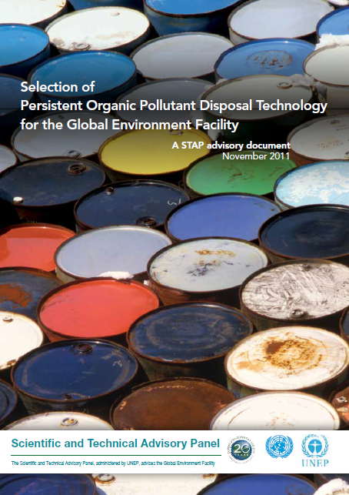
Recent STAP advisory products

Slide 8
Policies and methodologies
Learning objectives (RBM) – ongoing
Targeted research – ongoing
Criteria for focal area set asides (2010)
STAR (choice of indicators) (2009)
Notes:
At the policy level, STAP is working with the GEF on RBM and KM, revising the TR policy. It also has defined criteria for focal area set asides, helped shape the GEF – 5 focal area strategies; and, assisted the GEF in the selection and use of indicators for the STAR.
Photo credit – National Geographic – earth day pictures planet from space - Minas Gerais state of Brazil
Source - http://news.nationalgeographic.com/news/2011/04/pictures/110422-earth-day-2011-earth-day-google-doodle-satellite-from-space-pictures-nasa-astronauts/#/earth-day-pictures-planet-from-space-minas-gerais-brazil_34999_600x450.jpg

Slide 9
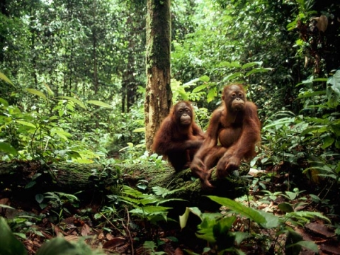
Project and programme level engagement
Strengthen the scientific and technical quality of
GEF projects and programmatic approaches, through
a screening of the PIF’s, focusing on FSPs
Responsible for targeted research
(project reviews and policy review – Principles for GEF
financing of Targeted Research, 1997)
Collaborate with the GEF Evaluation Office (focal area studies, assessment of quality at entry)
Notes:
Some examples of STAP’s advice at the project and program level, include the following:
1. “Ensure the scientific…”
2. “Responsible for…”
- Currently, STAP is conducting an analysis of targeted research with a view to consider updating the targeted research policy of 1997.
3. “Advise…”
Photo credit – Sundalands – biodiversity hotspot http://society.ezinemark.com/threatened-biodiversity-hotspots-7736a01d8c7a.html

Slide 10
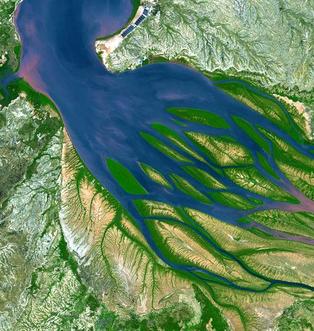
Overview of STAP screening of PIF’s
Screening versus reviewing
Done for all FSP’s
STAP’s summary for FSPs –
Consent
Minor revision
Major revision
Notes:
The objective of STAP’s screens is to strengthen the scientific and technical basis of the GEF proposals. Instead of conducting a proper review of the proposal, STAP screens the proposal since it is cognizant the PIF includes only the basic concepts of a full proposal. Having said this, STAP believes the PIF should be methodologically sound. Bearing this in mind, it uses three types of categories to rate the quality of the PIF –
Consent – which STAP attributes to a PIF which is scientifically and technically solid. It is likely that STAP will still provide a number of comments to strengthen the proposal further.
Minor revision and major revision – it usually reserves these two ratings for PIFs that either include an innovative component that needs further development in the full proposal or 2) the proposal demonstrates major barriers in its implementation due to a weak methodology. In either instance, STAP specficies what it expects the Agency to address during the full proposal.
(we may wish to note that typically once a recommendation is given, it is up to the relevant technical staff in GEF Secretariat to ensure that STAP’s advice has been taken into consideration in final project design. Exceptionally, STAP’s advice can be sought out in assisting in project design or in project implementation – however STAP’s resources are limited).
Photo credit – national geographic: earth day pictures planet from space bombetoka bay madagascar, 2011
Source: http://news.nationalgeographic.com/news/2011/04/pictures/110422-earth-day-2011-earth-day-google-doodle-satellite-from-space-pictures-nasa-astronauts/#/earth-day-pictures-planet-from-space-eleuthera-island-bahamas_34995_600x450.jpg

Slide 11
What does STAP look for in the PIF’s – 1?
Consistency with focal area strategy & objectives
Effective and appropriate use of RBM framework to define outputs, outcomes and relevant indicators
Do project outcomes encompass GEB’s (vulnerability reduction / adaptive capacity enhancement in the case of LDCF/SCCF), and can outputs be measured and linked to the outcomes?
Baseline description
Quantitative baselines preferred, should provide a feasible basis for measuring outcomes. In the case of adaptation, includes current vulnerability and potential future climate change risks

Slide 12
What does STAP look for in the PIF’s – 2?
Incremental cost reasoning
Scientific justification for the incremental activities, and the generation of GEB’s (e.g., carbon sequestration rather than sustainable land management)
In the case of adaptation, the intervention responds to the additional burden posed by climate change to the baseline (BAU) developmental activities.
Other aspects
Gender
Project risks; including climate change risks (enhancing climate-resilience of GEF projects)
Leveraging knowledge and learning from other projects including GEF projects

Slide 13
STAP welcomes the [agencies] proposal “Sustainable Agricultural Livelihoods in Marginal Areas (SALMA) in Lebanon. The proposal addresses an important climate-sensitive sector in a vulnerable region; and the project matches the focal area strategic objectives well. That said, STAP believes that the project could be strengthened further by a more comprehensive description of the intended interventions. Currently, these are lacking in detail, and it is therefore difficult to assess and validate the scientific and technical underpinnings of the proposed interventions. STAP recommends addressing the following points during the proposal / project development:
STAP recommends detailing further each component, and its expected outcome. Also, it suggests detailing explicitly the adaptation benefits and defining indicators for each benefit in the full proposal. Currently, the benefits are not specific in the description of the adaptation activities in B.2. Likewise, STAP recommends including the baseline data, or a timeline when the data will be collected, as well as explain how the baseline will be measured and monitored during the project implementation. Furthermore, STAP recommends defining further to what extent the baseline activities will help in addressing future climate change. This information will strengthen the additional cost reasoning of the intended interventions.
In the project overview, STAP recommends detailing farmers’ access to markets in the targeted region (proximity to markets, etc.). This information is important for evaluating farmers’ ability to successfully adopt high value horticultural crops as a result of irrigation.
To further understand the climate change risks facing the targeted regions, STAP recommends adding climate change projections for Lebanon, or the project region if possible, in the project overview section. One source for this information is Lebanon’s climate change profile from UNDP and the University of Oxford School of Geography and the Environment http://www.geog.ox.ac.uk/research/climate/projects/undp-cp/index.html?country=Lebanon&d1=Reports
Under component two, STAP recommends detailing further what tree species will be used in the afforestation efforts. If the tree species are not native, STAP suggests the World Bank undertakes a risk assessment of invasive species during the project development.
Additionally, it would be useful for the full proposal to consider the implications of climate change on the tree seedlings, and other forest area changes. Information in the IPCC Special Report on Extremes (Managing the risks of extreme events and disasters to advance climate change adaptation, IPCC 2012) may be relevant.
Under component 3, STAP recommends defining the methodology that will be used to train the project recipients to estimate and monitor the carbon stock changes. One potential methodology (and tools) the World Bank may wish to consider is the UNEP/GEF Carbon Benefits Project, which is setup to use Tier 1, 2, 3 default values (The GEF Secretariat has further information on this methodology and suite of tools.).

Slide 14
Example: STAP’s 2012-2013 work programme for Climate change adaptation (SCCF/LDCF)
Support to GEF-6 strategy process
Scientific and technical inputs for the National Adaptation Plans
Background and scientific inputs for the NAP process; for use by GEF Sec, IA’s and countries
Strengthening adaptation benefits in multi-trust fund projects
Internal guidance for GEF Sec and agencies for making adaptation benefits explicit in project design
PIF screening

Slide 15
Thank you!
Anand Patwardhan
STAP Member for Adaptation (apat@umd.edu)
STAP Secretariat
stapsec@unep.org
with copies to guadalupe.duron@unep.org
www.stapgef.org

